Slide 1

Building your Clubs
Social Media Presence
Lori Robinson,
District 4 Communications Team
Notes:
Social Media with D4 Communications Lori Robinson: How to build your club’s social media presence using Facebook, Instagram, Twitter. Will your club have the most likes or shares in D4?
Our goal today is to learn how to use social media effectively with Facebook Page / Instagram / Twitter
Social Media is the new word of mouth, the most trusted way for people to get recommendations and information.
I believe if each of us were to share a story today, we could easily increase the traffic to our social media page by no less than 10%
I challenge all of you to grab one post from Zonta District 4 page and share on your personal social media platform. May I even suggest the pinned post regarding the 2022 ZI Convention. I am going to show you how.

Slide 2

Social Media
Notes:
I am happy to be here to share what I have learned in a few short months. I am by far an expert, however I am proof that if you want to learn something, all you need is time and practice.
Posting on social media increases brand awareness and makes you more visible to potential members or event participants . By posting regularly, you make sure that your audience see more of you. Naturally, you shouldn't spam people with too many posts each day. However, irregular and rare posting will cause your audience to forget you.
Who attending is looks after a club facebook/Instagram or twitter.????????
Who here has personal Facebook? Instagram? Twitter?
Who know how to follow and Like.?
Who here knows how to share?
What about the importance of hash tags??????
Facebook is the media of choice to pursue as a club as it has the highest participation of women, and women age 35 plus.
Instagram is now trending among younger women, millennials, but is used significantly less around the world.
So if you can only do one social media, choose Facebook, If your volunteers can keep up with to add Instagram, Instagram is owned by Facebook, and you can actually post from an Instagram account to your Facebook page, but not the other way around.
Twitter is predominantly used by the Press Politics, and young men in tech, and a growing number of women as well.
It is least likely to be effective for most long to clubs, so we recommended as a third choice in most countries, but it could be useful, especially for reaching out to politicians regarding advocacy.

Slide 3
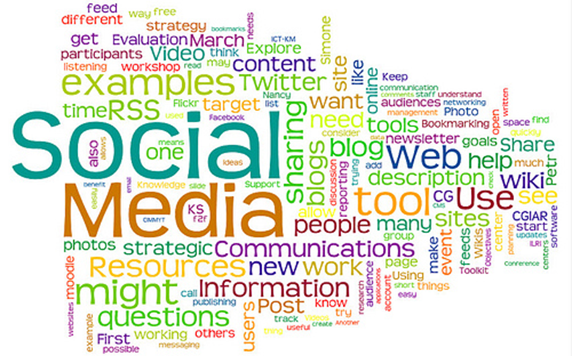
Notes:
Why Is Regular Posting on Social Media Important?
More shares and better SERPs Search Engine Results Pages
Trending on social media is beneficial for your club, area and district because it gets you more shares and increases your SERP ranking. If you want to trend on social media, you have to post regularly, as that increases your searchability.
1) More brand awareness
Posting on social media increases brand awareness and makes you more visible to potential customers. By posting regularly, you make sure that your customers see more of you. Naturally, you shouldn’t spam people with too many posts each day. However, irregular and rare posting will cause your audience to forget you.
2) Improved conversion rates
Every single one of the posts you make on social media can entice potential members to join or participate in your events or fundraisers . By posting regularly and increasing your visibility, you gain more chances to improve your overall conversion rates.
3) Helps with brand recognition ZONTA
We all know how important building brand loyalty is in today’s world. However, it’s not easily achieved, but regular social media posts will help.
Another useful aspect of social media marketing is how it helps you learn about your potential members. By posting regularly, you can gain further insights into what kind of posts work and which don’t.
Can also improve visibility on line and in your community

Slide 4

How Often to Post on Social Media
Notes:
How Often to Post on Social Media
Now that you know how vital regular posting is, it’s time to tell you how often you should do it.
Keep in mind this is very general information and will vary based on your desired immediate community presence and your targeted audience.
Facebook – One time per day at least three times per week is the optimal amount. The exact time depends on your target audience and when they are most active on Facebook.
Twitter – Five to ten times a day. Most users on Twitter are active between 8 am and 4 pm, so you should schedule your posts between those hours.
Instagram – One to two times per day, every day. OR, you could focus on engaging with other accounts for about 15 minutes/day and you won’t need to post as often to see results.
LinkedIn – Once per day, Monday through Friday – the best time to post on LinkedIn is in the morning, typically between 10 am and 11 am.
YouTube – It doesn’t matter how often you post on YouTube. What matters on YouTube is consistency. The best time to upload videos is on Thursdays and Fridays between 12 pm and 3 pm for the time zone where most of your subscribers are.
Pinterest – Five to 30 pins per day, most days. The more pins you pin, the better.

Slide 5
Help us post your information easily, quickly, and accurately
In a Word document- so we can copy and paste
A title
Blurb- approximately 150 words or less- brief description
Any links or hashtags
A longer description for events with all the details
Poster
If you want us to link to a poster, it can be a pdf.
If you want us to show the entire poster, must be a jpeg.
Pictures
Must be either a jpeg or png.
Please do not include in the Word document as it wont copy
Notes:
HELP US HELP YOU
If you want the District 4 Communications Team to SHARE your events or successes
Please send all of this attached to an email, not embedded in it. WORD DOCUMENT IS BEST Your email can give posting instructions.
We cannot get information easily from a link to a website. You must get out the information you want.
We cannot get information from a Power Point.
We cannot copy from the body of an email. The formatting is all wrong.
Thanks so much for your assistance. The Communications Team spends many hours preparing the D4 website, the D4 E News and the D4 social media accounts- Facebook, Twitter and Instagram. We appreciate your cooperation.

Slide 6

SHARING ZONTA POSTS
ON YOUR PERSONAL SOCIAL MEDIA PAGE
Notes:
Why do we post on Facebook?
69% said they share information because it allows them to feel more involved in the world. To get the word out about causes they care about. 84% of respondents share because it is a good way to support causes or issues they care about.
If you’re on your mobile or computer, the interface of Facebook should be the same
If you’re on the main “feed” page- where all the updated posts are collected,
You will see a search bar on top
Type in “Zonta”… by demographics, the closest club or the Facebook page you view the most with the word Zonta district 4 will pop up.
Using likes to increase visibility works on Facebook, Instagram, and Twitter, So, it's a good habit to get into.
Facebook works by taking the information that you share, and then sharing it with the friends of people who, like, comment, or share your posts.
In this way, you can expand your reach through a friend of a friend contact.
When you post. Think about the friend of a friend. If they see your post, will they understand it? Will they want to like it, or share it?

Slide 7
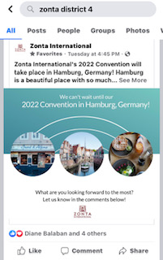
Facebook
Go on your
facebook page
On the top “Search” bar,
type zonta district 4
Notes:
How do I share a post I see on my News Feed on Facebook?
Below a post, click Share in the bottom right.
Select where you want to share the post. Depending on the post's privacy settings, you may see the following options: Share now. Share to News Feed. Share to Your Story. Send in Messenger. Share to a group. Share on a friend's profile. Share to a Page.

Slide 8
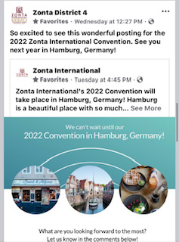
You now have an option to:
Share Now
-post as posted
Write a post
-adding comments to add to the post or
Send as Message
Notes:
You now have options.
Share Now- will allow you to post the story as is
This will automatically be added to your page.
Write a Post-
Allows you to customize the post. Maybe you want to have your targeted audience to focus on a specific activity or prizes…
This option you can add comments to the post before posting to your network
Send a Message
If you were talking to a friend and they want you to send the link to them directly, use this option
Personalizing a post helps your audience better understand why you are supportive of this post.

Slide 9

Build Connections with Like-Minded People
Notes:
Instagram is a visual platform to help you form a more personal connection with club members, prospective members and supporters.
Build Connections with Like-Minded People
Social media is all about networking. And Instagram is a great place to find like-minded people who share similar interests. You can expand your social network and collaborate with a brand or influencer to reach more people.
Another reason why you should be on Instagram is because it can help you make the most of new trends. You can use it to promote causes or simply generate interest by posting event or holiday-specific content.

Slide 10
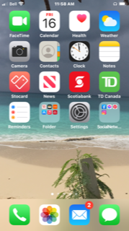

Instagram
Only on phone
Photos and short text
Open app
Notes:
Open Instagram App on your mobile by selecting the icon
There are some hacks where by you can load to Instagram from a computer. Most are cumbersome.
There are some social media packages or apps such as Hootsuite

Slide 11
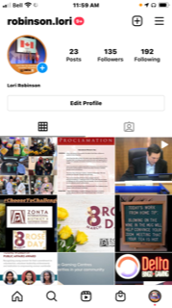
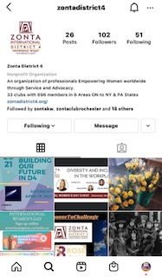
Look for the Magnifying Glass
Click on the Magnifying Glass
Type in Zonta District 4
Notes:
Lets look at sharing a D4 Instagram post form our personal account.
Once on Instagram, look for the “MAGNIFYING GLASS” to search
Search by typing in “Zonta District 4 on the search bar and it should pop up
Click on that page

Slide 12
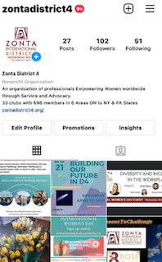
Once you’re on the Zonta District 4 page,
Click on the post you would like to repost on your page.
(Every box) is post you can share
Notes:
Once you’re on the Zonta District 4 page, Notice we have 102 followers since I opened the account this year. Since Feb 1st 2021 So now we need to get the followers up to the number of members and interested parties.
#zontadistrict4 so all the postings come together.
Click on the post you would like to repost on your page.
(Every box) is post you can share
Find a post you’d
like to share with your personal network tap the photo box

Slide 13
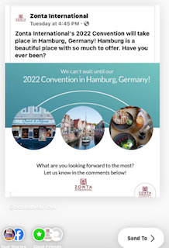
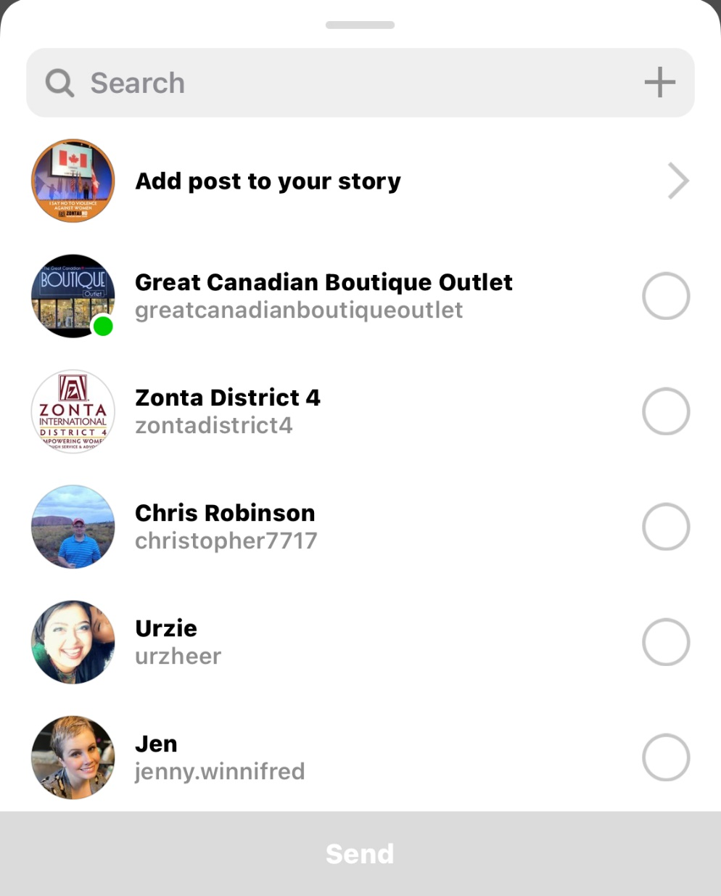
Notes:
Search to find where you want to share as you can see I have shared to Add post to my story
And on the second screen shot you can see at the bottom right I have options in my permissions to share with my facebook as well however here I am going to click on “your story’

Slide 14
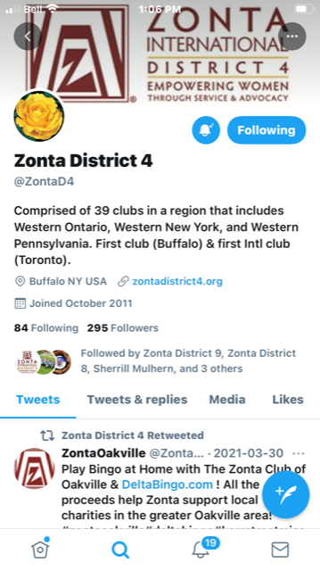

Twitter
Notes:
Twitter the District 4 Twitter is done by Area Direct 3 Kat.
Most are done by retweets
How do you retweet?

Slide 15
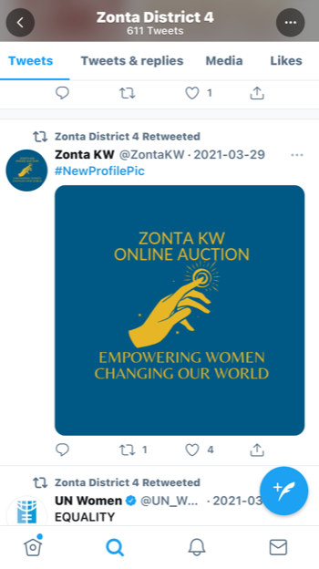
Retweet
Zonta District 4
Retweeted from the Zonta Club of
Kitchener Waterloo.
Notes:
Go to the Tweet you'd like to share:
Tap the Retweet icon. That little square box with the arrows
Tap Retweet as Quote Tweet.
Add your own comment. You also have the option to include media. Choose between one GIF, up to four photos, or a video.
Tap Retweet.
Voila

Slide 16
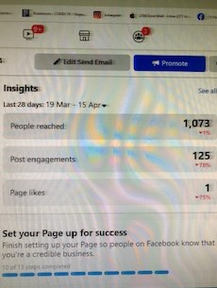
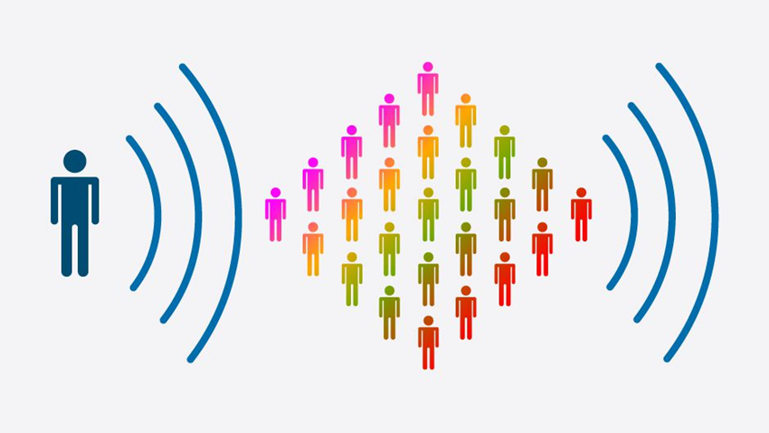
Get the numbers up
Notes:
For FB we have reached 1,073 since March 19th I want to see at least 10 % increase and I will share in the District news letter.
There is lots out there to share.
Like and follow and SHARE that is how we are going to get the IMPORTANT words out there.
Social media, for sure has taken an huge boost because of COVID

Slide 17
Zonta International
Zonta Leadership program
https://www.zonta.org/Web/My_Zonta/Tools/Leadership
5.5 Social Media Best Practices
Social Media at the Club level
https://www.gotostage.com/channel/55756b4d9b5b477d8a8373446fa5194f/recording/b54d052bc6084ab2a31e5231f0413107/watch?source=CHANNEL
Notes:
For more information visit Zonta.org My Zonta tools zonta leadership program

Slide 18

Thank you so much for your attention
Notes:
Our clubs in the District are doing a lot of great things.
Fundraisers, seminars and workshops and some fabulous panels. Lets learn what is out there and the share the information. We can take this opportunity to SHRARE the great work we are all doing out there.
where else are you going???? Not far.

