Slide 1
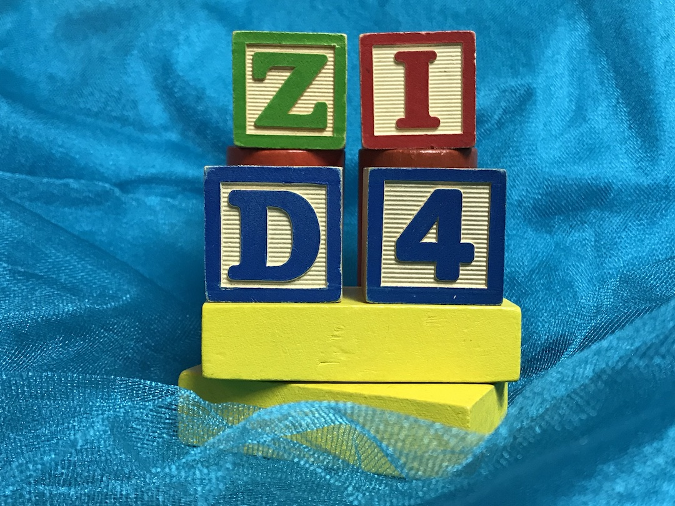


D4
Learning
November 1, 2021
Building Our Future:
Transitions, Changes & New Opportunities Accomplished Through Teamwork

Slide 2
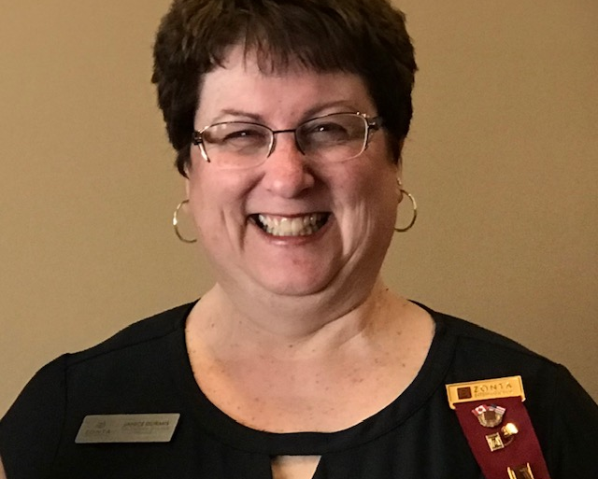
Welcome
Governor Janice Durmis
Building Our Future:
Transitions, Changes & New Opportunities Accomplished Through Teamwork

Slide 3
D4
Learning
Amelia Earhart
Holly Anderson,
Zonta International & District 4 Chairperson
Building Our Future:
Transitions, Changes & New Opportunities Accomplished Through Teamwork

Slide 4
What is the Amelia Earhart Fellowship?
The Amelia Earhart Fellowships Program, launched in 1938, commemorates groundbreaking aviator and Zontian Amelia Earhart.
  The fellowship was for women studying at the post-graduate level in Aerospace engineering and space sciences.
  Ellen Parks, then serving as Zonta International President, remembered, "At that time few women considered a career in aerospace engineering, yet not one voice of doubt was raised as to the success of such a scholarship."
Even today women make up only 25 percent of the workforce in the aerospace industry.
Zonta International offers the Amelia Earhart Fellowship as part of its mission that women have access to all resources and are represented in decision-making positions on an equal basis with men.
Building Our Future:
Transitions, Changes & New Opportunities Accomplished Through Teamwork

Slide 5
FELLOWSHIP DESCRIPTION
The US$10,000 Fellowship is awarded annually to up to 35 women pursuing Ph.D./doctoral degrees in aerospace engineering and space sciences. It may be used at any university or college offering accredited post-graduate courses and degrees in these fields.
Since the program’s inception in 1938, Zonta has awarded 1,674 Amelia Earhart Fellowships, totaling more than US$11 million, to 1,245 women from 75 countries.
Our Fellows have gone on to become astronauts, aerospace engineers, astronomers, professors, geologists, business owners, heads of companies, even Secretary of the US Air Force. In 2020 AE Fellow Andrea Ghez (1987) won the Nobel Prize for Physics!
Building Our Future:
Transitions, Changes & New Opportunities Accomplished Through Teamwork

Slide 6
Who Funds the Amelia Earhart Fellowship Program?
Zonta International relies on the members in the districts to support the program.
Clubs can help support the program:
  By raising awareness of the fellowship among your members, educational institutions and young women in your district
  By fundraising for the program in your club and area gatherings
Building Our Future:
Transitions, Changes & New Opportunities Accomplished Through Teamwork

Slide 7
What clubs can do to raise awareness of the program?
Hold a program meeting to provide information on the award
  Describe the purpose of the award and its history;
  Encourage support through the ZI Foundation
Show the videos suggested in this presentation and discuss what your club can do to:
  Promote the importance of the award to women who are striving to make significant progress in their careers
  Encourage young women in your area to continue with science, technology and math studies to keep their post-secondary options open by working with young women in your area; e.g., in your Z-clubs
If a university in your area offers aerospace or space science studies at the PhD level, speak to the registrar about the award and ask them to encourage young women in their PhD programs to apply
Building Our Future:
Transitions, Changes & New Opportunities Accomplished Through Teamwork

Slide 8
Suggested Videos for Promotion of the AE program
Amelia Earhart’s vision of economic independence ( 3 minutes):
  https://www.youtube.com/watch?v=lqi-VFvQVKg
Meet Sharon (5 minutes):
  https://www.youtube.com/watch?v=jFoT5cuteio
2017 Fellow Bella Kim (3 minutes):
  https://www.youtube.com/watch?v=uPEhdUErpok
2012 Fellow Catharine Evans interviewed by PIP Lynn McKenzie(4 minutes):
  https://www.youtube.com/watch?v=14eoamjAQrU
AE Fellow Beth Jens( 8 minutes):
  https://www.youtube.com/watch?v=lXPkeOsOONo
Building Our Future:
Transitions, Changes & New Opportunities Accomplished Through Teamwork

Slide 9
Amelia Earhart Promotional Materials
AE Fellowship Program description:
  https://www.zonta.org/images/docs/MyZonta/Tools/AwardScholarshipFellowshipTools/AE/AEFellowshipStatsProgramOverview.pdf
AE Fellows Biographies:
  https://www.zonta.org/images/docs/MyZonta/Tools/AwardScholarshipFellowshipTools/AE/AEFellowsBios.pdf
AE Fellows Map:
  https://www.zonta.org/images/docs/MyZonta/Tools/AwardScholarshipFellowshipTools/AE/AEMap.pdf
AE Fellowship Poster:
  https://www.zonta.org/images/docs/MyZonta/Tools/AwardScholarshipFellowshipTools/AE/AEPoster.pdf
Building Our Future:
Transitions, Changes & New Opportunities Accomplished Through Teamwork

Slide 10

Thank you for your attention
Building Our Future:
Transitions, Changes & New Opportunities Accomplished Through Teamwork

Slide 11
The 16 Days of Activism is fast approaching.
What’s your plan?
Building Our Future:
Transitions, Changes & New Opportunities Accomplished Through Teamwork

Slide 12
D4
Learning
Communications
Sandra Cronk (emails) Alice Tyler (E-News),
Kat Bunyan McClendon (ZI & D4 social media), Lori Robinson (club social media),
Sheena Poole (website)
D4 Communication Team
Building Our Future:
Transitions, Changes & New Opportunities Accomplished Through Teamwork

Slide 13

Welcome to Everyone
We’re here to help!
Help us help you
Building Our Future:
Transitions, Changes & New Opportunities Accomplished Through Teamwork
Notes:
Welcome to communications portion of tonight
Purpose today is to help us help you to get the word out about Zonta
Will use upcoming 16 Days campaign as our examples but methods will be transferable to many aspects of Zonta
We are not experts- I am an insurance broker, Alice, a social worker, Sheena was donor development & fundraising for non-profits, Kat works for Service Canada and Lori owned a human resources company.
We have all learned that jumping in feet first, sometimes taking a community college course, but mainly just practice and error is how we all arrived on the communications team. You can learn how as well. We are all here to help.

Slide 14

Outline of tonight’s agenda:
Sandra - Introduction
Alice - review Guidelines
Sheena - what and where to find content on the websites
Kat - demonstration of posting 16 Days on social media
Lori - wrap-up
Questions
Notes:
Begin with Alice , who will review the D4 Communications guideline about how to submit items to our team, and why it makes everyone’s job easier.
Then Sheena will show you what and where to find material for posting on ZI and D4 websites, including the guidelines for Zonta branding.
Kat will then do live demonstration of how to post 16 Days items on various social media sites.
Lori will wrap up
Please hold your questions until the end of our presentation, although you can type questions in the chat at anytime. They might be answered in a later section, but otherwise, we will answer at the end.
Thanks again for attending, and let’s all learn together!
Alice will begin our presentation

Slide 15
Zonta D4 Communication Guidelines
Help Us Post Your Information Easily & Accurately
Message in Word Document
Title & subtitles
Brief promotional description (blurb) for social media posts.
Include any links / hashtags.
Longer description for events – we may use a button link for “more information” or “registration details” to link to our Facebook page or website
Ensure content is grammatically appropriate with correct spelling
Notes:
Deadlines – for E-News – 1st and 3rd Thursday of each month except July and August (mid-month)
Documents - we will copy and paste the Word document (no photos)
Promotional description about 150 words
We’ll start a longer article with a few lines, then use button to ‘Read more’

Slide 16
Zonta D4 Communication Guidelines
Posters
If you want us to show entire poster, use jpeg as we’re unable to copy & paste a poster. Tip: You can use a free website to convert pdf to jpeg i.e. freepdfconvert.com, pdf2jpg.net
If you want us to insert a link to a poster, then the poster can be a pdf.
Links within the poster will not be active. Place the link in a Word document for us to create an active link.
Notes:
Google ‘convert pdf to jpeg’- look for total free process- some may advertise free trials

Slide 17
Zonta D4 Communication Guidelines
Pictures
Must be either a jpeg or png – attach separately to the email (we can’t copy and paste a photo from a Word doc, email or poster)
Please do not embed photos in an email.
Include any image captions – who, what, when, where – in a Word document
Notes:
Please specify what info/people belong to which picture- we don’t create a caption.

Slide 18
Zonta D4 Communication Guidelines
Copyright
Be mindful of where you are and who you are photographing
    Consent is not required in a public place, but discretion should be used.
Images, videos, music, must comply with copyright laws. Clubs will be held accountable for copyright infringement violations.
Notes:
We may be more active in displaying photographs during upcoming 16 Days of Activism, so we want to be cautious re: our surroundings- don’t want any images to be misconstrued or have certain labels which wouldn’t reflect well on Zonta. Perhaps each club should have a risk management policy.
Be especially cautious in photographing service recipients or children.(check with agency- may be able to photograph backs of heads or use a special disclosure or consent form)

Slide 19
Zonta D4 Communication Guidelines
Additional Guidelines
Please send all Word docs and photos in an email but do not embed the message in the email as the formatting isn’t correct.
We post content; we do not create it.
  we cannot transfer information from a link to a website or a Powerpoint– you must place the information you want to be posted in a Word document.
Notes:
Thanks so much for your assistance in making this process easier.
Next up is Sheena who will show you what and where to find material for posting on ZI and D4 websites, including the guidelines for Zonta branding.

Slide 20
Where to Find Advocacy (ZSN)
& Other Committee Resources
Zonta International
District 4
Zonta International https://zonta.org/
My Zonta (right hand side or top middle)
Select Tools from dropdown list
Select Advocacy
  Zonta Say NO – PR tools
  Zonta Says NO Toolkit
District 4 https://zontadistrict4.org
Building Our Clubs
Committee Resources
Advocacy
  Advocacy Calendar
  Zonta Says No 2021 Campaign
Building Our Future:
Transitions, Changes & New Opportunities Accomplished Through Teamwork
Notes:
Demonstration where content is located on the Zonta International website
Has a large amount of content for the Zonta Says NO campaign. Images are placed in Dropbox for download.
Best Practices for Following the Zonta Says NO to Violence Against Women Campaign on Social Media
Share your story. 5 tips to capture your campaign most effectively
Zonta Says NO Press Release for Club Activity
Zonta Says NO Logo
Social Media Images
Facebook Profile Photo Frame
Infographics
Zonta Says NO Eye Images
Zonta Says NO Pull up Banner
Zonta Says NO Horizontal Banner
Zonta Says NO PowerPoint Image
Zonta Says NO PowerPoint Template
District 4 Advocacy Committee has developed additional material to help you get the word out without exhausting time and energy. Share and learn from each other!
Similarly, other committee like Communications had created content for your club to use. Check out the other committee resources.

Slide 21
Zonta D4 Communication Tools
Zonta International
District 4
https://zonta.org/
My Zonta (right hand side or top middle)
Select Tools from dropdown list
Select PR Tools and Logos
  Communications Tools
https://zontadistrict4.org
Select Building Our Clubs
Or
Select Committee Resources
  Communications Committee
ZI Branding Identity Guideline,
ZI Brand Identity Policy,
ZI Image Copyright Guide
D4 Communications Guidelines
D4 Social Media Release Example
Building Our Future:
Transitions, Changes & New Opportunities Accomplished Through Teamwork
Notes:
Zonta International
PR TOOLS such as
Brand Identity Guidelines | PDF
Photography Examples | PDF
Photography Tips | PDF
PowerPoint Template | PPT
Zonta Image Copyright Guide | PDF
Zonta International Press Kit – General Information | PDF
Zonta Quick Guide | PDF
Logos for clubs
contact ZI
District 4
Communications Committee Resources & under Club Business
ZI Branding Identity Guideline, ZI Brand Identity Policy, ZI Image Copyright Guide
D4 Communications
Thank you, let us know if you require other information not found on our site.
Next up is Kat who will then do live demonstration of how to post 16 Days items on various social media sites.

Slide 22
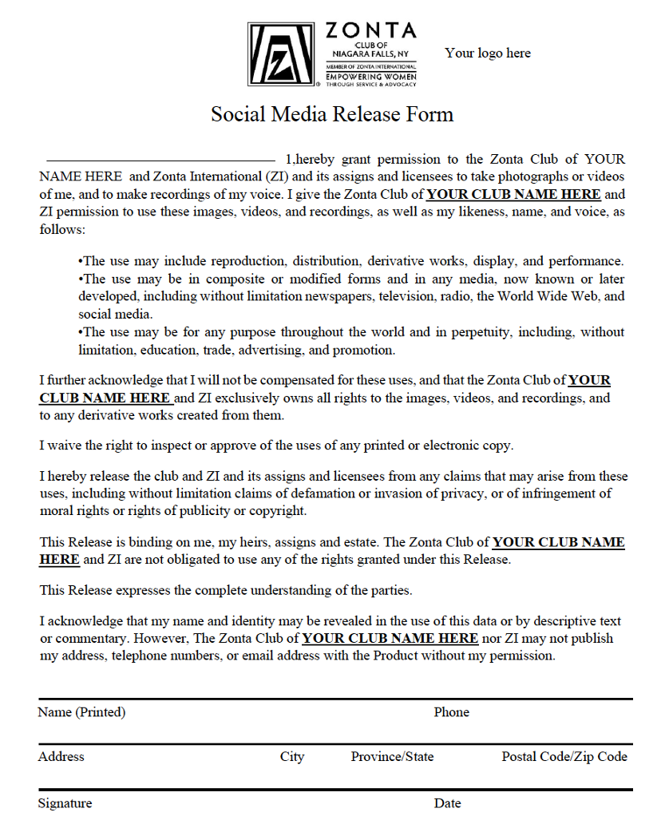
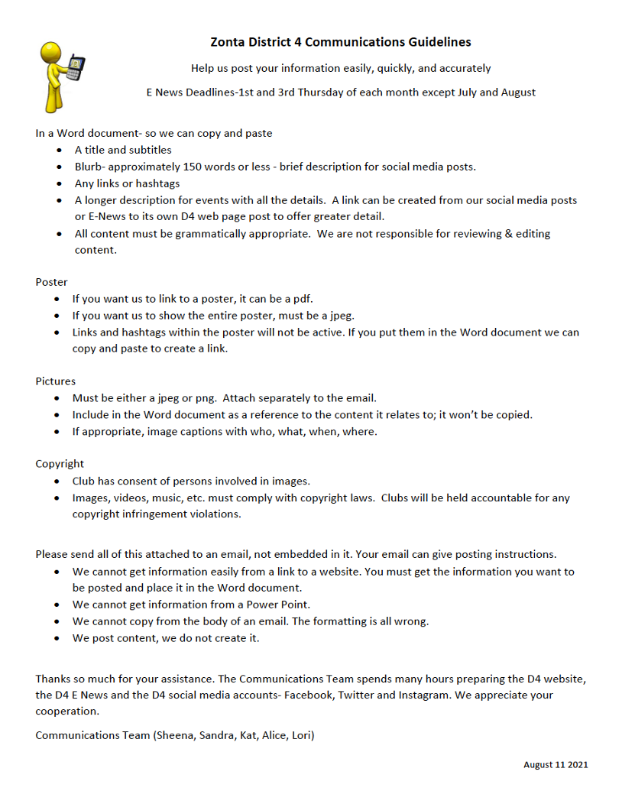
Zonta D4 Communication Tools
Social Media Release Form
D4 Communications Guidelines
D4 Communications Guidelines
D4 Social Media Release Example
Building Our Future:
Transitions, Changes & New Opportunities Accomplished Through Teamwork
Notes:
District 4
Communications Committee Resources & under Club Business
D4 Communications Guidelines & example of a social media release form (Kat’s club has offered their form for example. At the beginning of each year the club has members (including Z-Club) complete one. We also give it to speakers or award recipients that we photograph.
Thank you, let us know if you require other information not found on our site.
Next up is Kat who will then do live demonstration of how to post 16 Days items on various social media sites.

Slide 23

3 Elements to creating a Social Media Post
Text/Information
#ZontaSaysNO
#ZontaD4
@ZontaIntl
@ZontaD4
Building Our Future:
Transitions, Changes & New Opportunities Accomplished Through Teamwork
Notes:
There are 3 Elements to creating a successful Social Media Post:
1. Your Text or Information you want to Share
2. An eye-catching photo
3. The Hashtags & Twitter handles related to your post
Now you are ready Tagging and Sharing with others

Slide 24
Where are the tools?
District 4 Advocacy Committee
Zonta.org
Zontasayno.com
UN Women
Building Our Future:
Transitions, Changes & New Opportunities Accomplished Through Teamwork
Notes:
1. Our District website (Sheena would have shared previously) the Advocacy Tools
2. Zonta.org. My Zonta > Tools > Advocacy Tools> Zonta Say No to Violence Against Women Tool Kit
3. Zonta Says No website. PR Tools, Infographics and multiple images for Social Media
4. UN Women (under “What we Do” Ending Violence against Women) Facts and figures, global perspective

Slide 25


Get out and show your support.
Say NO to Violence Against Women.
#ZontaSaysNO
#ZontaD4
#AWorldWithoutViolence
Building Our Future:
Transitions, Changes & New Opportunities Accomplished Through Teamwork
Notes:
Advocacy Committee will provide you will a calendar of suggested events.
Communications will provide you with a picture, sample/suggested text and Hashtags and Twitter handles
Feel free to personalized your information…these are just suggestions to help you

Slide 26

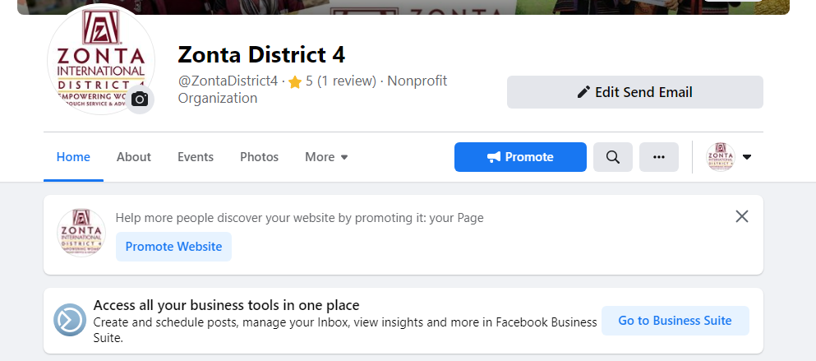
Posting on Facebook
&
Instagram
Building Our Future:
Transitions, Changes & New Opportunities Accomplished Through Teamwork
Notes:
Facebook and Instagram are linked so you came post on both platforms simultaneously
Plan post in advance. Set aside take to schedule all you post at once and then you can supplement it with additional information if you would like. Scheduling post for Facebook,/Instagram and Twitter must be done from your computer. The option for scheduling is not available on the mobile app
Facebook posts can only be scheduled with the new “Business Suite” option. You can no longer schedule posts on a “personal” account. All of our Zonta accounts are linked to the Administrators “Personal” account. Instead of selecting “Create Post in Facebook” you select “Create Post in Business Suite”. This will give you all the necessary options to schedule posts.

Slide 27
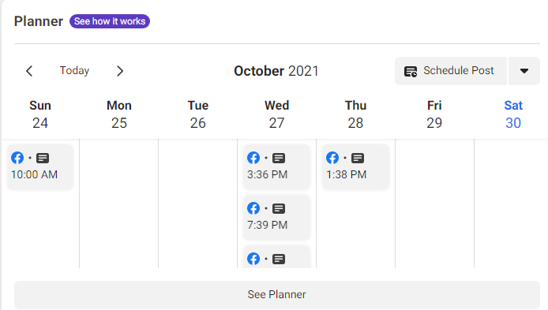
Posting on Facebook
&
Instagram
Building Our Future:
Transitions, Changes & New Opportunities Accomplished Through Teamwork
Notes:
When in the “Business Suite” scroll down to Planner section. This is where you will schedule and create your post.
Select “Schedule Post”
Select the Date and Time you would like your post to appear
Add the Text you would like in your post – this will appear above your photo
Add your photo
Under Placements – if you have an Instagram account it will show you here. If you would like the same post to go onto Instagram select it
“Facebook Text” box is where you are going to put your Hashtags and Twitter handles (this will appear below your picture)
Select Schedule Post and that is it
Repeat the process for all 16 Days
This is a good feature to schedule posts for the month
You can check all of your scheduled post by review the calendar

Slide 28

Get out and show your support.
Say NO to Violence Against Women
#ZontaSayNo #ZontaD4 #Aworldwithoutviolence @ZontaIntl @ZontaD4
www.zontasaysno.com
Building Our Future:
Transitions, Changes & New Opportunities Accomplished Through Teamwork
Notes:
This is a sample of the information you need to a Twitter post.
Again we will provide you with a picture, sample text and Hashtags and Twitter handles

Slide 29
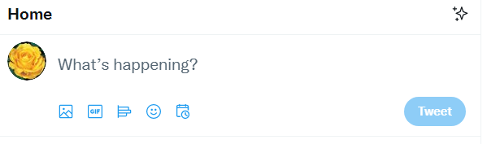
Posting on
Twitter
Building Our Future:
Transitions, Changes & New Opportunities Accomplished Through Teamwork
Notes:
Log into Twitter on your computer
Put in your text
Add your photo
4. At the bottom of the “What’s happening? Click on the last Icon which is a little calendar
5. Select the date and time for your tweet
6. Click Confirm at the top right
7. The tweet option in the bottom right corner has changed to Schedule. Click that
8. You can view you scheduled tweets and edit or delete them if necessary

Slide 30
Let’s try it
Live Demo
Building Our Future:
Transitions, Changes & New Opportunities Accomplished Through Teamwork
Notes:
Thank you, let us know if you require additional assistance posting to social media.
Next up is Lori who will wrap our presentation and leave you with a few reminders.

Slide 31
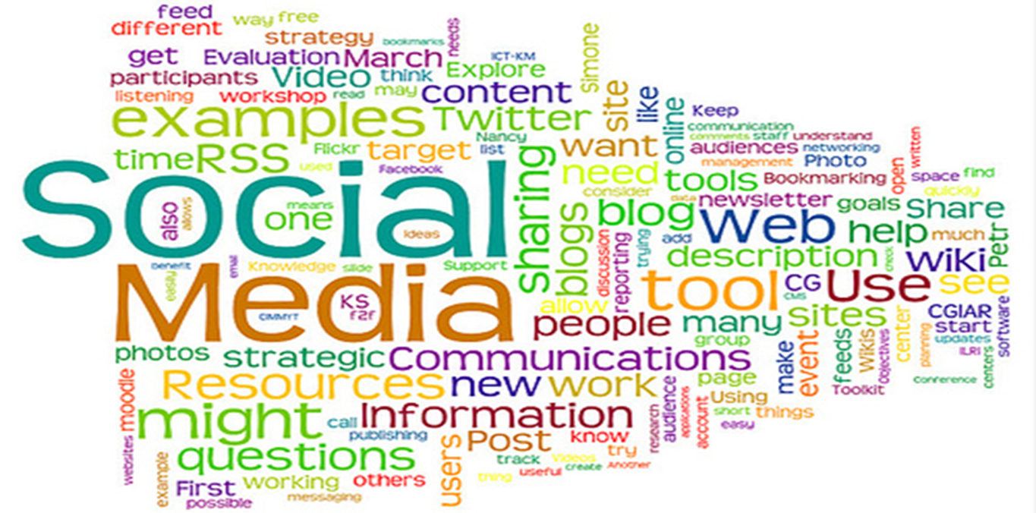
Putting it all together
Building Our Future:
Transitions, Changes & New Opportunities Accomplished Through Teamwork
Notes:
Thanks to the team for gathering such great information and showing us where to locate items that we can use as they are or take bits and pieces to make them custom to our needs.
Zonta International has great staff that put the information together along with talented and well versed INTERNATIONAL VOLUNTEERS
ZONTA DISTRICT 4 HAS A GREAT WEBMASTER AND FABULOUS COMMITTEES THAT WORK TO POPULATE THE CONTENT FOR YOUR USE.
Don’t spend hours recreating something if we can share what is already created. You now know where to look for the information and how to download to use it.
By using pictures and articles that are from the Zonta International website you can be certain that they are safe to use and cost free.
Going rogue could lead to copyright infringements and cost to your club. Make sure that you have permission to use photos of people and also make sure the setting is appropriate to the message that you want to send Do not take chances and Don’t take the risk!

Slide 32
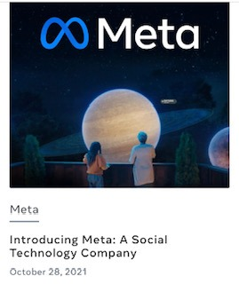



Sharing Zonta posts on your personal social media pages increase the traffic
Building Our Future:
Transitions, Changes & New Opportunities Accomplished Through Teamwork
Notes:
Like and follow and SHARE that is how we are going to get the IMPORTANT words out there
Remember this information is to help you and if you want communications to post HELP US HELP YOU
If you want the District 4 Communications Team to SHARE your events or successes
Please send all of this attached to an email, not embedded in it. WORD DOCUMENT IS BEST Your email can give posting instructions.
We cannot get information easily from a link to a website. You must get out the information you want.
We cannot get information from a Power Point.
We cannot copy from the body of an email. The formatting is all wrong. Remember we are all volunteers and we want to help you get your information out. If it is easy for us to do it gets done much faster.
Thanks so much for your assistance. The Communications Team spends many hours preparing the D4 website, the D4 E News and the D4 social media accounts- Facebook, Twitter and Instagram. We appreciate your cooperation.

Slide 33

Thank you for attending this session on
Getting the Word Out!
Questions?
Building Our Future:
Transitions, Changes & New Opportunities Accomplished Through Teamwork
Notes:
On behalf of the District 4 Communications’ Team, we appreciate your interest and attention tonight. We welcome any questions or additional resources you would like to see from us.

Slide 34
D4 Update
Governor Janice Durmis
Building Our Future:
Transitions, Changes & New Opportunities Accomplished Through Teamwork

Slide 35
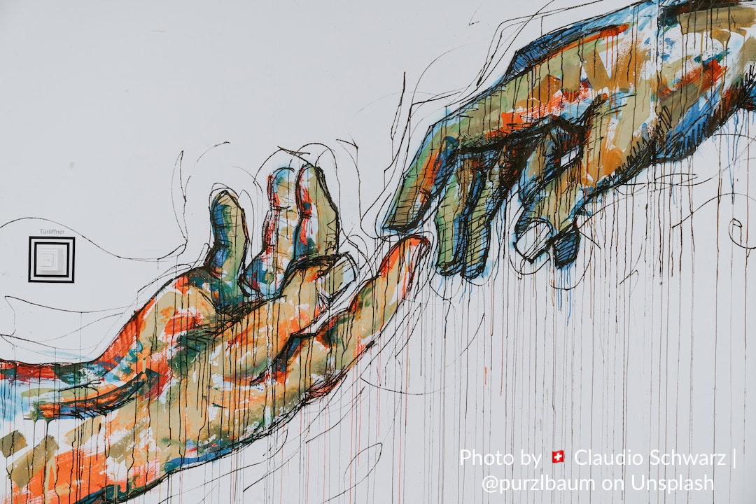
Thank You for Attending
Contact Us
for Help
or to Share
communications@zontadistrict4.org
Building Our Future:
Transitions, Changes & New Opportunities Accomplished Through Teamwork

