Slide 1
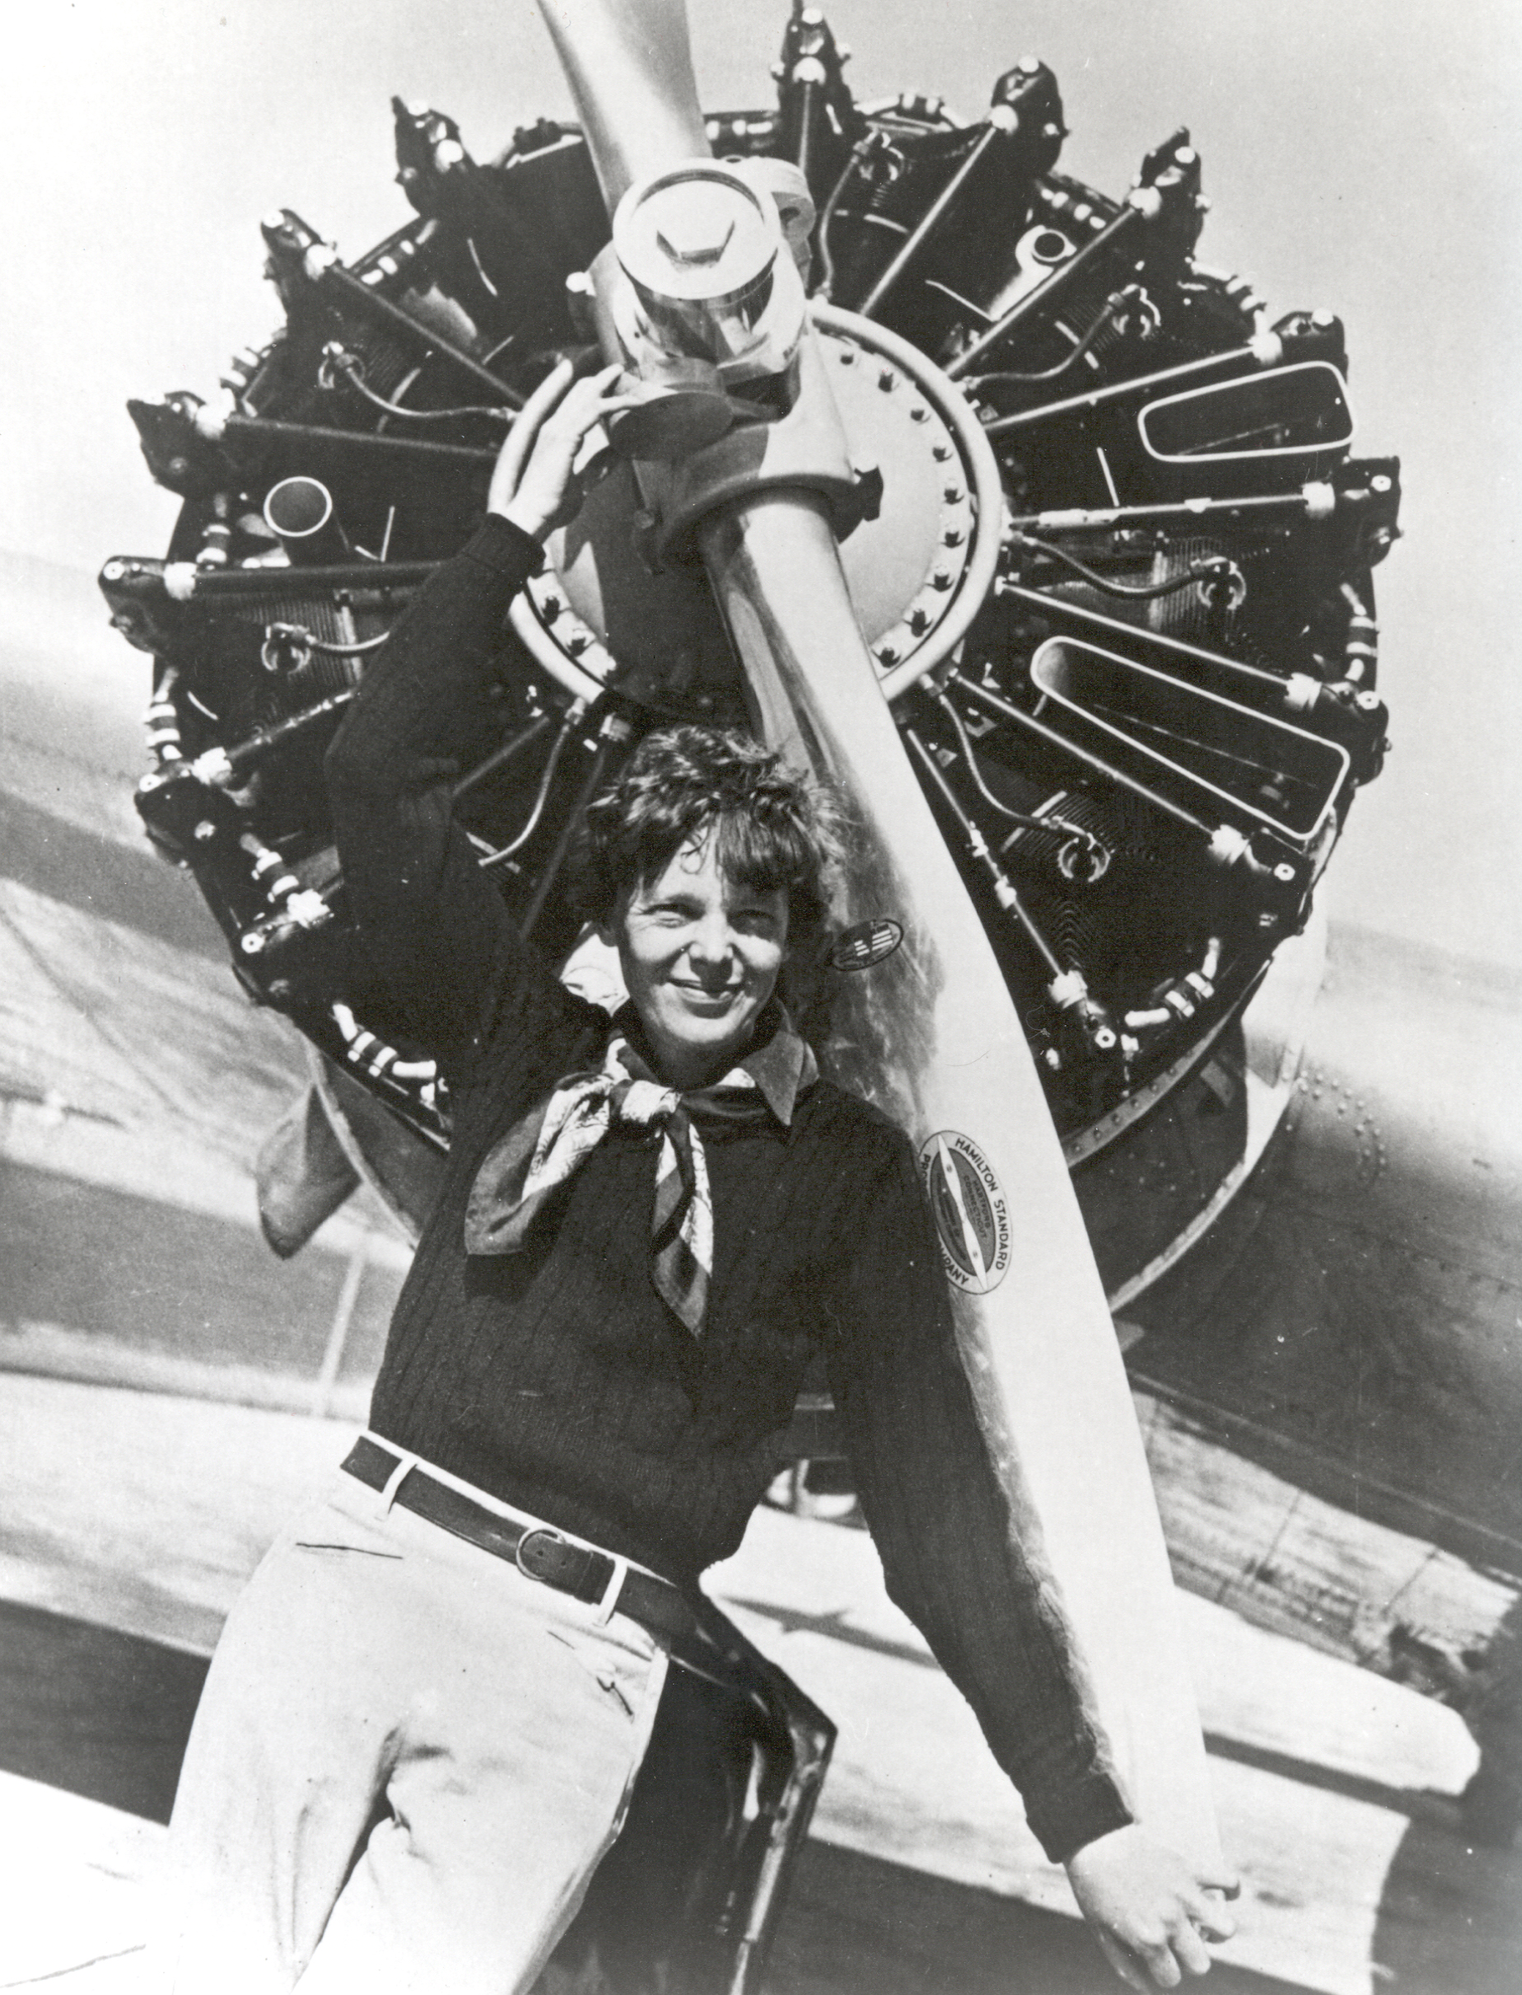
The
Amelia Earhart Fellowship

Slide 2
Who was Amelia Earhart and Why does Zonta care?

Slide 3

Who was Amelia Earhart
Amelia Earhart is one of the most famous American pilots
A record setting aviator, she was:
  the second person to fly solo and nonstop across the Atlantic,
  the first person to fly solo and nonstop across the United States,
  A member of Zonta,
  and much more

Slide 4
A few facts about Amelia you may not know*
First Woman Vice President of the National Aeronautic Association
  Earhart became the first woman vice president of the National Aeronautic Association, which authorized official records and races
Politically Outspoken
  Earhart lobbied Congress for aviation legislation. She also lobbied for birth control rights, supported women in politics and business, and endorsed the draft for men, women, and even the elderly to promote equality and peace.
Entrepreneur and Fashion Designer
  Earhart designed a line of "functional" women's clothing, including dresses, blouses, pants, suits, and hats, initially using her own sewing machine, dress form, and seamstress. She modeled her own designs for promotional spreads.

Slide 5
A few facts about Amelia you may not know*
College Professor
  In 1935, Earhart became a visiting professor at Purdue University at the invitation of Purdue president Edward Elliott, an advocate of higher education for women, especially in engineering and science.
  Earhart, a former premedical student, served as a counselor for women and a lecturer in aeronautics.
  Elliott was also interested in supporting Earhart's flying career and convinced Purdue benefactors to purchase a twin-engine Lockheed 10-E Electra for her.
* Information from the Smithsonian Exhibition Women in Aviation and Space History

Slide 6
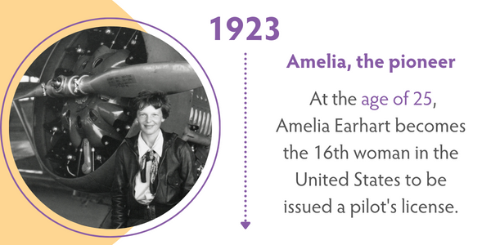

Slide 7
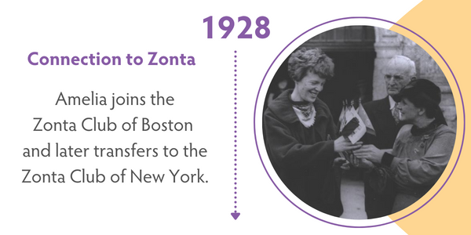
Notes:
On the strength of her achievements, Amelia became famous, working with George Putnam whom she later married. Amelia used her fame to promote the idea that women could be active participants in non-traditional professions.

Slide 8
AMELIA EARHART & HER FIGHT FOR EQUALITY
Beyond Amelia’s accomplishments as a pilot, she wanted to make a statement about the role and worth of women’s ability to contribute to society
She dedicated much of her life to prove that women could excel in their chosen professions just like men and have equal value.

Slide 9
Promoting Women in Aviation
Earhart accepted a position as associate editor at Cosmopolitan and used it to campaign for greater public acceptance of aviation, especially focusing on the role of women entering the field
In 1934, Earhart interceded on behalf of Isabel Ebel, who had helped Earhart in 1932, to be accepted as the first woman student of aeronautical engineering at New York University (NYU).

Slide 10
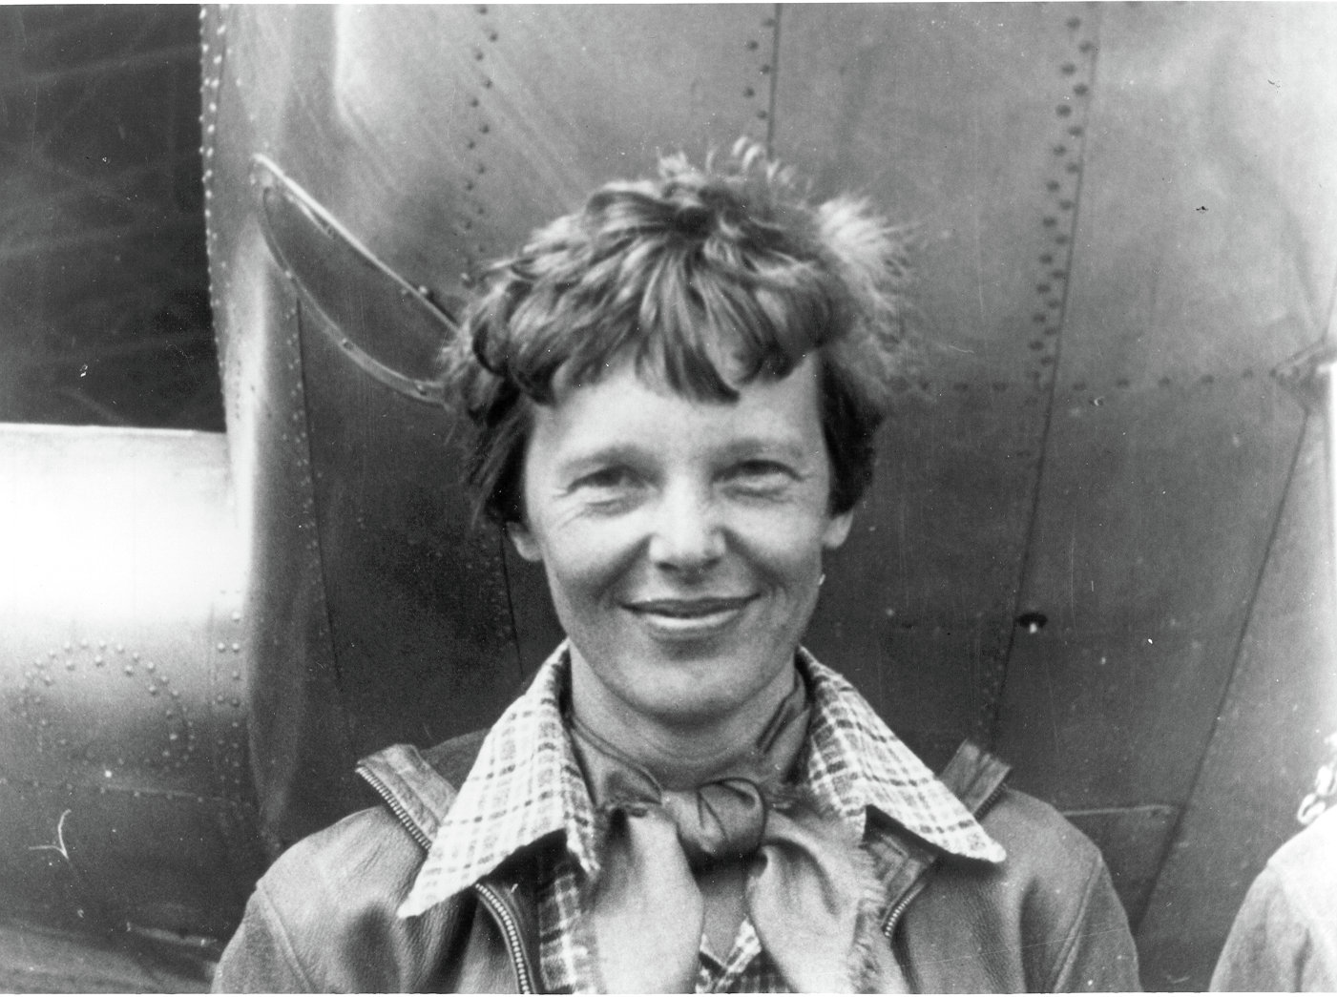
amelia earhart Disappears
She mysteriously disappeared in 1937 while trying to circumnavigate the globe from the equator. Amelia was legally declared dead in 1939.

Slide 11
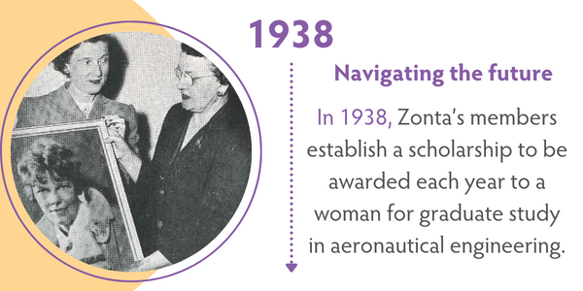

Slide 12
amelia earhart Day
Zonta International commemorates January 11 as Amelia Earhart Day:
  On 11 January 1935, Earhart embarked on a 2,408-mile trip from Honolulu, Hawaii to Oakland, California. The next day, she became the first person to fly solo to the United States mainland from Hawaii.

Slide 13
1938: WHEN ZONTA INTERNATIONAL ESTABLISHED THE AMELIA EARHART FELLOWSHIP
In 1938-39, aerospace was still in its infancy.
It took Zonta two years to find a single qualified applicant to receive the first fellowship.
Today women still make up only 25 percent of the workforce in the industries related to aerospace.
Notes:
Today, as evidence of the increasing numbers of women in aerospace engineering or space sciences, the challenge for Zonta is choosing the most promising women from among the many qualified applicants.

Slide 14
THE AMELIA EARHART FELLOWSHIP TODAY
Purpose
To empower women through encouragement and financial support of women pursuing Ph.D./doctoral degrees in aerospace engineering or space sciences.
Program Statistics
Since the inception of the program in 1938, there have been 1,764 Amelia Earhart Fellowships, totaling More than US$11.9 million, given to 1,335 women from 79 countries.
Notes:
Today, as evidence of the increasing numbers of women in aerospace engineering or space sciences, the challenge for Zonta is choosing the most promising women from among the many qualified applicants.

Slide 15
Notes:
Zonta’s longest-running program: Currently 30 fellowships awarded each year: $10,000 US;Alumnae have gone on to become astronauts, aerospace engineers, professors, CEOs, university presidents, senior managers at NASA….
Enables women to move beyond constraints of their birth to study at an advanced level abroad
Up to end of 2023 total: US$11.6 million,

Slide 16
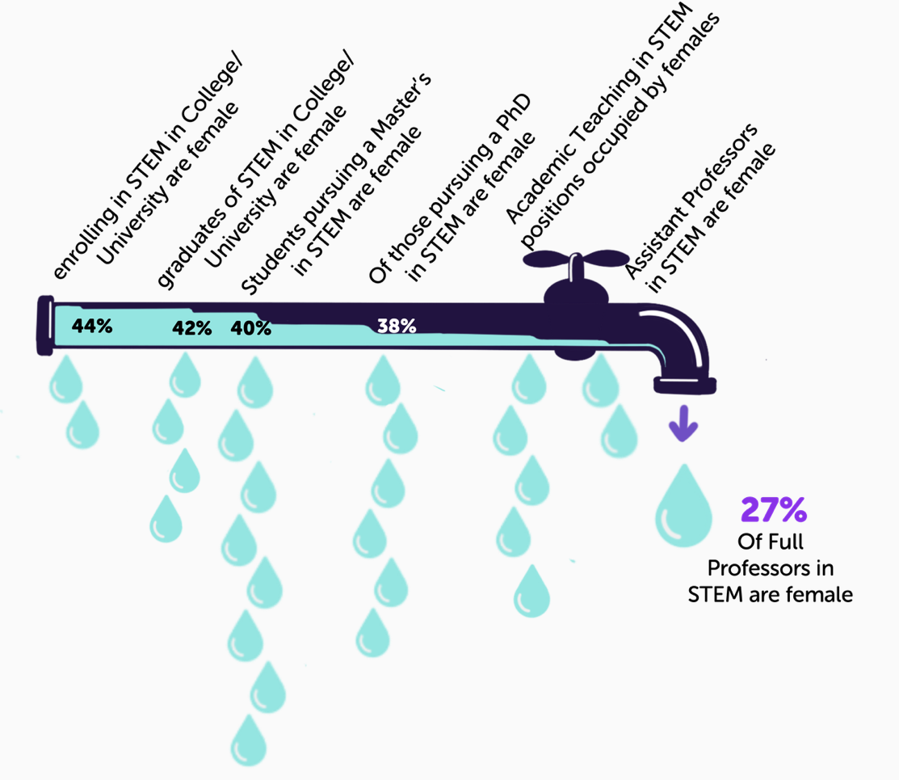
2023 was the 85th anniversary of the Fellowship
We award the fellowship because women are still underrepresented in STEM in all decision-making positions
Women earned more undergraduate and master’s degrees and 42% of bachelor’s degrees in STEM in 2019 but are still underrepresented at the PhD and faculty level (27%) *
*https://www.letsgetproof.com/blog/women-in-stem-the-leaky-pipeline

Slide 17
Women in Canada Are Less Likely to Enter and More Likely to Leave STEM Fields**
In 2019, women earned approximately one-third (36.4%) of all recipients of STEM postsecondary degrees in Canada.
  Among students earning bachelor’s degrees in 2019, women represented:
    All STEM subjects: 41.8%
    Science and science technology: 61.0%
    Engineering and engineering technology: 21.7%
    Mathematics and computer and information sciences: 31.4%
In 2021, women accounted for less than a quarter (23.5%) of those working in natural and applied sciences and related occupations.
    In these occupations, women earned, on average, $0.84 to every $1.00 earned by men in annual wages, salaries, and commissions in 2020.
**https://www.catalyst.org/research/women-in-science-technology-engineering-and-mathematics-stem/

Slide 18
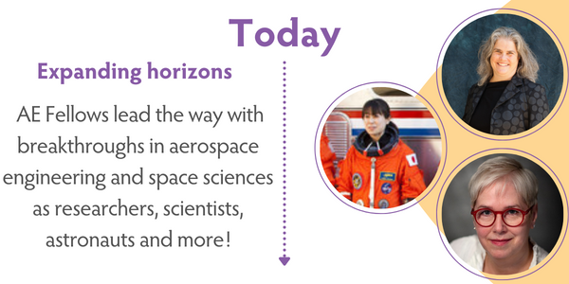

Slide 19
The Amelia Earhart Fellowship now
In Zonta we celebrate and reward these women who are working in advanced research
Education is the single greatest tool to advance the status of women and
  Advanced STEM education is needed in all economies in the world
“Allowing young women to feel both welcomed and included in STEM by ….ensuring they are encouraged in STEM and helping them build an identity around being a successful female in STEM will sufficiently improve the retention of women in these fields”*
*https://www.letsgetproof.com/blog/women-in-stem-the-leaky-pipeline

Slide 20
Funding
The fellowships are:
Funded from the annual donations of clubs, members and supporters of the Zonta Foundation for Women.
No funds come from annual membership dues

Slide 21
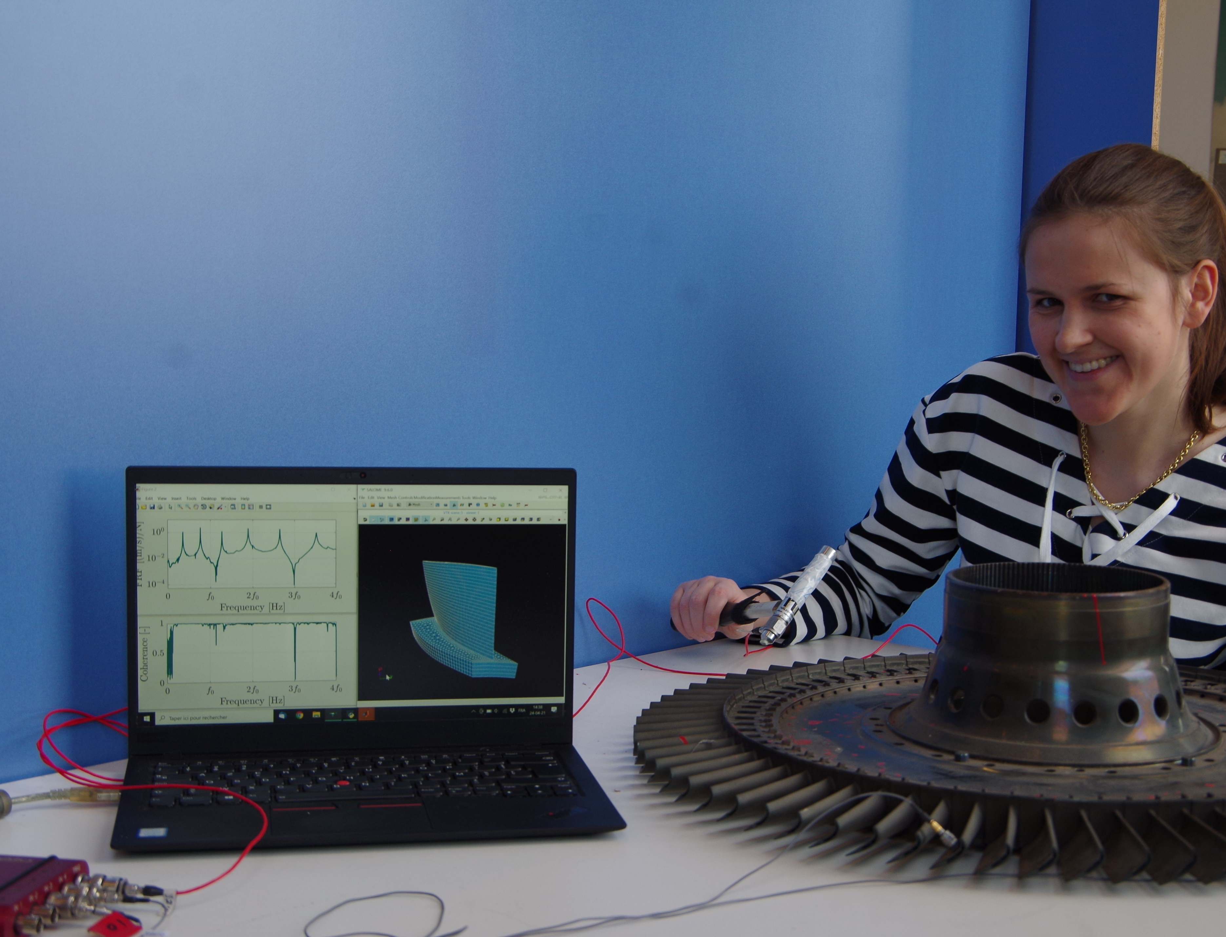
Raising awareness of the
AE Fellowship
Zonta International relies on the members in the districts to support the program by:
Raising awareness of the AE Fellowship among your members, educational institutions and young women in your district.
Fundraising for the program in your club and area gatherings.

Slide 22
Thank you!

