Slide 1
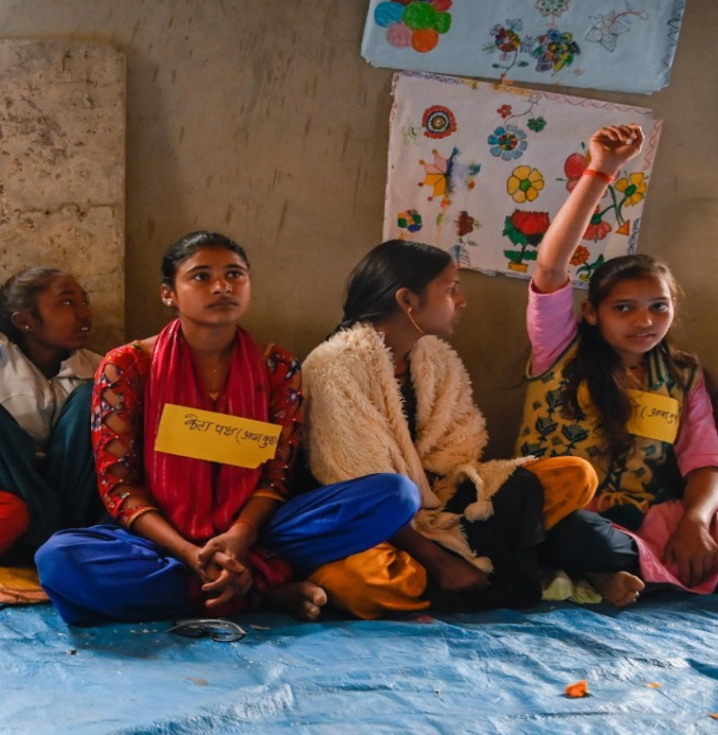
FOUNDATION AMBASSADOR
2024-2026 Biennium

Slide 2

DISTRICT 4 ZONTA FOUNDATION FOR WOMEN COMMITTEE
Diane Balaban, ZC Olean
Cheryl Gruber, ZC Warren
Sheena Poole, Chair, ZC Cross Border

Slide 3

THANK YOU,
District 4!
Notes:
THANK YOU for your personal donations. It is greatly appreciated and helping us as a district meet our goals and ZI of providing women and girls the opportunities to improve their lives.
Thank you, again!

Slide 4
In Zonta International, You Are One Of…
65
32
1,054
23,596
Countries
Districts
Clubs
Members

Slide 5
Zonta’s mission is to be a leading global organization of individuals working together to build a better world for women and girls.
As such, Zonta International supports service projects at the international level that unite the clubs and individual members globally.
This basic element of Zonta carries the expectation that every Zontian contribute to developing the Zonta Foundation for Women into an effective tool for building a better world for women and girls.
Zonta Foundation for Women recognizes that clubs and districts carry out their own service projects to help advance the mission of Zonta International, such activities must not interfere with the basic expectation that individual Zontians and clubs will support the Zonta International service programs and projects approved by the voting members at convention.

Slide 6
Members-Clubs Take an Active Role
Convention
Members Review & Vote on Club Actions from Call to Convention
Club Delegate Vote on ZFW Budget & Initiatives (projects)
By adopting the projects, members commit to funding them.
Club Presentation 2026

Slide 7
ZONTA FOUNDATION FOR WOMEN
Friends of Zonta
Funding supports the charitable service projects and education programs of Zonta International.
Zonta
Clubs
100% of donations are used for program support and implementation.
Zonta Members
Clubs are requested to give one-third of funds raised locally to the Foundation.
Dues are not donations. They do not support the Foundation’s expenses.
Notes:
Through the donations received by the Zonta Foundation for Women, we have a huge impact on improving the lives of women worldwide. To continue our influence, we must have a financially strong and sound foundation.
The Foundation’s revenues come from donations made by Zonta clubs, members, and friends of Zonta. Clubs are strongly encouraged to give at least 1/3 of funds raised locally to the Foundation, keeping up to 2/3 for their local service programs.
Last biennium, 82% of clubs made a gift. Our goal this biennium is to have100% of our clubs donate to the ZFW.
In some countries, tax and government regulations make individual donations more difficult.
We must also remember that each donation benefits the women and girls Zonta pledges to support. 100% of donations made to the Foundation go directly to program support. For this biennium, the Foundation is not receiving any funding from ZI to support operating expenses. The Foundation’s expenses will be covered by the Foundation’s investment income.
Please remember that our dues are not donations.
Only donations from active Zonta clubs and members are included in district totals, as are any solicited corporate donations.

Slide 8

Thank You, from ZI President Salla Tuominen
Link to Video
Notes:
In 2025 the ZI Foundation for Women held the 40 years campaign. Thanks to each member and club that participated the campaign was extremely successful.
Today, we hear a few words of appreciation from the Zonta International and Zonta Foundation for Women President Salla Tuominen

Slide 9
Zonta’s Yellow Rose Campaign

Slide 10



2024-2026 FUNDRAISING GOAL
Fundraising Goal = US$4,617,000
Fund | Agency Partner | Title | Proposed USD
International Service Projects |  | Laaha: A Virtual Safe Space for Women and Girls | 750,000
 |  | Climate Empower: Community Empowerment and Innovation for Gender-Transformative Climate Action | 1,000,000
 |  | Global Programme to End Child Marriage | 1,500,000
Educational Awards |  | Amelia Earhart Fellowships (total funding disbursed: $600,000) | 552,000
 |  | Zonta Young Women in Leadership Awards | 370,000
General |  | Rose Fund (Zonta Women in Business Leadership Award, Zonta Women in STEM Award, 2025 Jane M. Klausman Women in Business Scholarship) | 445,000
 |  | Total | 4,617,000
Club Presentation 2026
Notes:
For the 2024-2026 biennium, our fundraising goal is US$4,617,000. This goal was set by International President Salla Tuominen during her biennium as president-elect and approved by the Zonta Foundation for Women Finance Committee and Board.
The projects listed on this slide were adopted during convention in June 2024. The funds raised support the projects of the current biennium. If we do not raise the full amount, we must use reserves to meet our financial commitments. It is important that we do not rely on reserves and raise the money during our current biennium. If the proposed dollar amount is not raised for the international service projects or educational programs, the Rose Fund, as an unrestricted fund, would supply the difference. Of course, raising more than the set goal would be fantastic!

Slide 11






GIFT FUNDS
Amelia Earhart Fellowship Fund
Supports AE Fellowships
Zonta Young Women in Leadership Award Fund
International Service Fund
Amelia Earhart Fellowship Endowment Fund
Long-term income for the AE Fellowship program.
Rose Fund Unrestricted Underfunded, new programs of ZWIBL & ZWISTEM
Endowment Fund
Long-term income for the Foundation.
Club Presentation 2026
Notes:
These next two slides show the Foundations funds.
Amelia Earhart Fellowship Fund
Supports the AE Fellowships that are awarded each year to talented women, pursuing advanced studies in aerospace engineering and space sciences
Young Women in Public Affairs Award Fund
Supports YWPA Awards given to young women aged 16 to 19, who demonstrate a commitment to leadership in public policy, government and volunteer organizations.
International Service Fund
This fund supports programs that have provided training, educational, health, sanitation, agricultural and micro-credit assistance to women, primarily through projects implemented by agencies of the United Nations and other recognized non-governmental organizations. It supports all 4 International Service projects.

Slide 12

2024-2026
Zonta International Service Projects
Club Presentation 2026

Slide 13
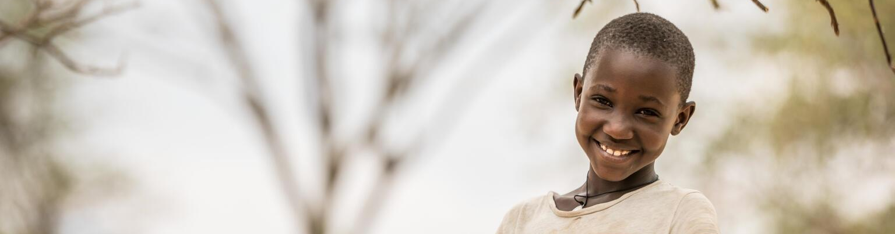





ENDING CHILD MARRIAGE: A PROGRAME TO ACCELERATE GLOBAL ACTION PHASE III
Funding: US$1,500,000
Globally, 21% of girls are married while they are still children, robbing them of their childhood.
Goal: Scale up the Global Programme’s activities to protect and empower girls, and ultimately help bring an end to the practice of child marriage.
The program’s priority is engaging adolescent girls as key agents of change in 12 countries which account for almost half of the world’s child marriage.
Club Presentation 2026
Notes:
Despite progress, child marriage remains a global crisis, with 650 million women and girls alive today married before age 18.
Backlash against gender equality, humanitarian crises, climate shocks and funding shortfalls. Resistance to girls’ rights—rooted in political, social and cultural opposition—threatens legal protections, limits access to education and health services, and undermines efforts to dismantle harmful norms and accelerate change.
This biennium, the project continues Phase III. During this time, the priority remains on engaging adolescent girls as key agents of change in the following 12 countries with high prevalence of child marriage: Bangladesh, Burkina Faso, Ethiopia, Ghana, India, Mozambique, Nepal, Niger, Sierra Leone, Uganda, Yemen and Zambia.
With renewed ambition toward 2030, the Global Programme will boost its actions to accelerate the decline in child marriage globally and respond to the combined effects of the polycrisis and the pushback against gender equality on adolescent girls.
PHASE III (2024-2026)
Zonta International’s continued support in the final phase of the Global Programme will focus on strengthening government capacity and ownership of the work and generating important evidence and data to sustain the program long term.
PHASE II (2020-2024)
Phase II brought increased political support, resources about healthy and safe decisions, gender-responsive policies, as well as enhanced investments in and support for both unmarried and married adolescent girls. Over 6.3 million adolescent girls were empowered with life skills and comprehensive sexuality education were delivered through safe spaces in communities and schools.
PHASE I (2016-2019)
In Phase I, almost 8 million adolescent girls were reached with life skills and school support, 39 million individuals engaged in community-based behavior change, and 26,000 schools strengthened their adolescent girl-friendly education.
Specific objectives include:
Elevate the voice and agency of adolescent girls by:
• Empowering marginalized adolescent girls through skills development and knowledge-building.
• Promoting gender equality in adolescent girls’ families and communities.
2. Increase resources and opportunities for adolescent girls and their families by:
• Strengthening education, health and child protection systems.
• Addressing the ways that poverty drives the practice of child marriage.
3. Enhance legal and political action to prevent child marriage and to support married, divorced or widowed adolescent girls by:
• Helping governments strengthen their plans to end child marriage.
• Building the capacity of governments to make data-driven decisions and implement evidence-driven programs.

Slide 14
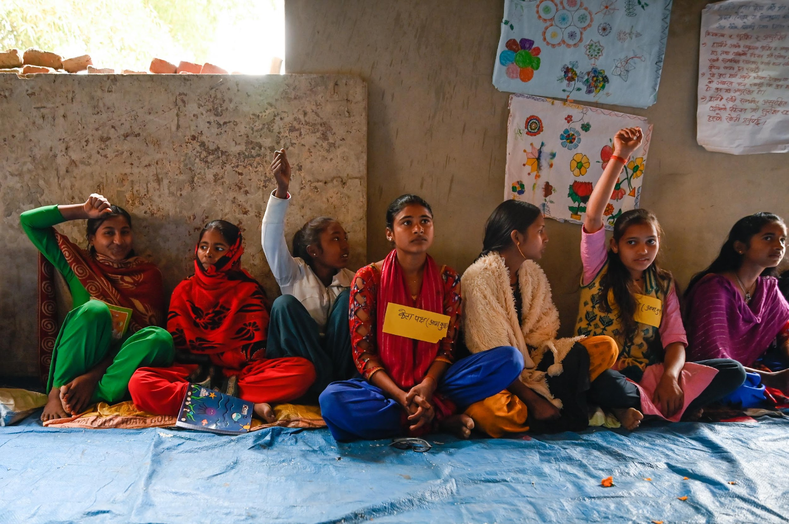

GLOBAL PROGRAMME TO END CHILD MARRIAGE – RESULTS TO DATE
7.5 million adolescent girls were empowered through life skills and comprehensive sexuality education.
Funding: US$ 1.500,000
Over 280 Million community members were reached by mass media messaging on child marriage, the rights of adolescent girls, and gender equality.
The number of Global Programme partnerships with women-led organizations increased from 74 (2023) to 133 in 2024
Club Presentation 2026
Notes:
Currently: will not meet the Sustainable Development Goal (UN) SDG 5.3: Eliminate Forced Marriages and Genital Mutilation by 2030, with an estimated nine million girls projected to marry that year.
Phase III of the Global Programme to End Child Marriage focuses on strengthening gender-transformative approaches, multisectoral action and partnerships. It prioritizes collaboration with youth, women-led and feminist organizations to counter growing pushback against gender equality and human rights. The programme also emphasizes investment in sexual and reproductive health, comprehensive sexuality education and protection services for adolescent girls. Launched in 2024, this phase renews global, regional and national commitments to ending child marriage worldwide.
Below is a selection of success across the twelve program countries in 2024:
Almost 7.5 million adolescent girls (aged 10-19) received life skills or comprehensive sexuality education interventions
4.8 million boys and men actively participated in group education and dialogues that address harmful gender norms
Also, 29.5 individuals were engaged in group education and dialogue sessions on the consequences of and alternatives to child marriage, as well as the rights of adolescent girls and gender equality
Almost 8.5 million adolescent girls were supported to enroll in, return to, or remain in school.
The program is experiencing amazing growth, with the number of partnerships with women-led organizations increasing from 72 in 2023 to 133 in 2024.
The Global Programme was also able to partner with 1,361 youth-led organizations, both formal and informal, in 2024.
In 2024, 2.5 million boys and girls accessed prevention and protection services, and over 3.5 million girls were able to benefit from social protection, poverty reduction, and economic empowerment programs.

Slide 15
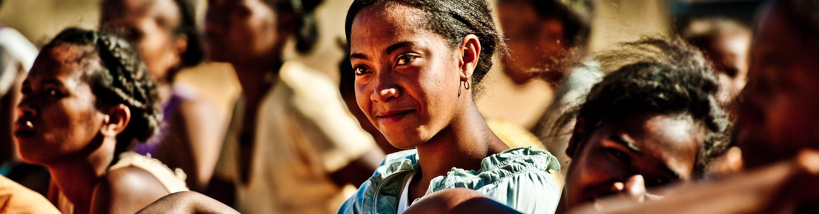



CLIMATE EMPOWER: COMMUNITY EMPOWERMENT AND INNOVATION FOR GENDER-TRANSFORMATIVE CLIMATE ACTION
Funding: US$1,000,000
Climate change impacts women and girls and their sexual and reproductive health and rights.
Access to food, water, shelter and livelihoods is disrupted.
Child marriage and intimate partner violence increases.
Goal: Prevent climate-induced gender based-violence (GBV) and other harmful practices through interwoven innovative approaches and community-driven interventions in Madagascar, Mozambique and South Sudan.
Approximately 500,000 direct and indirect beneficiaries will be equipped with knowledge of the impacts of climate change and trained to identify and initiate solutions to build resilience against climate-induced GBV.
Club Presentation 2026
Notes:
Climate Empower was initiated because of the harmful gender norms and inequalities that intensify with climate change, leaving women and girls more vulnerable in times of crisis. In Madagascar, Mozambique and South Sudan, climate shocks incite intimate partner violence, child marriage and loss of autonomy for girls.
Climate Empower is addressing challenges rooted in harmful norms and climate stress. Menstruation taboos, for example, cause isolation and unsafe hygiene, worsened by strained water access—95% of women in vulnerable areas of Madagascar walk longer than 30 minutes for water. Meanwhile, adolescent pregnancy remains high, with Mozambique recording 180 births per 1,000 girls aged 15–19; and, in South Sudan, the teenage pregnancy rate is estimated at 30%. Climate shocks further fuel childbearing pressures, exploitation and poor health outcomes for women and girls.
This is a new project for this biennium that is intended to prevent climate-induced gender-based violence (GBV) and other harmful practices in Madagascar, Mozambique and South Sudan – some of the countries most vulnerable to climate change globally.
With rising temperatures, the impact of climate change in Africa is likely to further exacerbate poverty and inequality and increase the occurrence of extreme events such as cyclones and flash floods, droughts and extreme heat, destroying livelihoods and access to essential services.
As these events become more frequent, conflicts due to the disruption of livelihood and community infrastructure will devastate women and girls. Climate challenges are fueled by persistent and deeply rooted discriminatory sociocultural norms that justify or tolerate violence against women and girls and limit their autonomy in many areas of life (i.e., education, healthcare, economic empowerment), especially women and young girls in rural areas.
Women and girls’ roles need to be leveraged as leaders in promoting climate change resilient community actions, as these are the individuals from vulnerable communities who experience the most challenging impacts of climate change. Their active involvement, therefore, in finding solutions is crucial to more gender transformative, lasting change. By integrating their perspectives, solutions are better tailored to protect all community members, specifically addressing the intersection of climate stressors and GBV.

Slide 16



LAAHA: A VIRTUAL SAFE SPACE- RESULTS TO DATE
Laaha has reached 1.5 million users with support and accessible, relevant information.
Funding: US $750,000
Laaha is now available in 13 languages, with plans to reach 15 by the end of 2025, and prioritizes accessibility through audio narration for low-literacy users.
Participants reported feeling “less alone” and more empowered. Moderators observed deep engagement on service access and mental health.
Club Presentation 2026
Notes:
While Laaha has successfully created a human-centered approach with community engagement, new challenges have arisen with the growth of the platform. UNICEF and partners are now working on enhancing personalization in the chat box, expanding language support and simplifying and improving navigation and content searching. UNICEF is also in the process of finding ways to embed Laaha into service delivery frameworks to improve adaptability.
Going forward, the Laaha team will focus on scaling safety and sustainability while staying community driven. UNICEF will establish a Girls’ Council and advisory board, expand inclusive access through AI-powered translation and voiceovers and develop interactive voice response systems for offline use. UNICEF plans to roll out Laaha in Bangladesh, Democratic Republic of Congo, Haiti, Pacific Islands, Sudan and Syria. With improved navigation and content discoverability, Laaha aims to remain a vital, resilient tool supporting women and girls in crises worldwide.
UNICEF is focused on scaling Laaha globally to reach as many girls in as many regions as possible, expanding language and developing alternatives like Interactive Voice Response systems for low-connectivity regions.
Laaha has reached 1.5 million users, with usage expanding even to countries where it hasn’t formally launched, such as Saudi Arabia, Algeria, Indonesia, Egypt, and Germany.
Laaha is now available in 13 languages, with plans to reach 15 by the end of 2025. UNICEF collaborates with country offices, government ministries, and local NGOs to localize Laaha’s content. This includes translating and adapting content to local dialects and embedding the platform into community outreach.
Accessibility was prioritized through audio narration for low- literacy users. Voiceovers were recorded by native speakers, often with input from local youth to enhance relatability.
Testing in December 2024 showed high engagement. Participants reported feeling “less alone” and more empowered. Moderators saw deep engagement on service access and mental health, signaling Laaha’s potential to foster safe online communities where physical ones are limited.

Slide 17

UNICEF – USA
Appreciation Video
Link
Club Presentation 2026

Slide 18


2024-2026
Zonta International Educational Awards
Club Presentation 2026

Slide 19
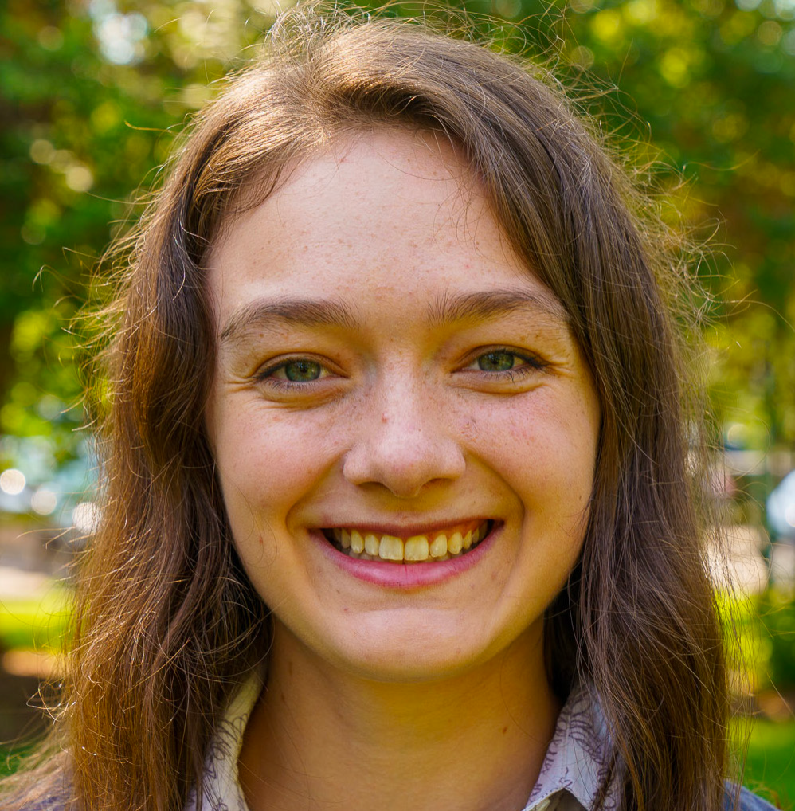

AMELIA EARHART FELLOWSHIP
2024-2026 total funding: US$600,000
60 fellowships of US$10,000 each to women pursuing Ph.D./doctoral degrees in aerospace engineering and space sciences.
Carolyn Pethrick
2025 Amelia Earhart Fellow (D2)
Club Presentation 2026
Notes:
One of Zonta International’s longest-running programs is the Amelia Earhart Fellowship. It was established in 1938. This program expands opportunities for women pursuing advanced studies in aerospace engineering and space sciences.
Since the program’s inception, Zonta has awarded 1,764 Amelia Earhart Fellowships, totaling more than US$11.9 million, to 1,335 women from 79 countries.
Carolyn Pethrick is a 2025 Amelia Earhart Fellow.
Carolyn is a Ph.D. candidate in mechanical engineering at McGill University in Montreal, Quebec. She conducts her research in the Computational Aerodynamics Group under the supervision of Professor Siva Nadarajah. Her work addresses the energy intensity of the aerospace industry by developing high-fidelity computational tools for aerodynamic simulation, enabling engineers to improve efficiency without compromising safety.

Slide 20
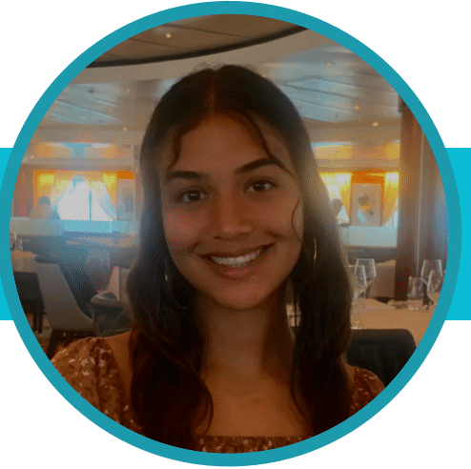
ZONTA YOUNG WOMEN IN LEADERSHIP AWARD
2024-2026 total funding: US$370,000
37 international awards of US$5,000 each.
The five districts with the most members will select two awardees.
Valeria Gonzalez-Sukhai
D4 2025 YWILA Awardee
Zonta Club of Hamilton1
Club Presentation 2026
Notes:
The Zonta Young Women in Leadership Award (formerly Young Women in Public Affairs Award YWPA) recognizes young women between the ages of 16-19 for their commitment to the volunteer sector, evidence of volunteer leadership achievements and dedication to empowering women worldwide through service and advocacy. Established in 1990 by Past International President Leneen Forde, Zonta has given 1,128 awards, US$1,673,750, to 956 young women from 61 countries.
D4 Awardee for 2025 is Valeria Gonzalez-Sukhai submitted by the Zonta Club of Hamilton1
Valeria Gonzalez-Sukhai is a student leader and an advocate for inclusive, compassionate environments. While working as an administrative assistant at a midwifery clinic, she recognized the importance of community outreach in healthcare, motivating her to create a welcoming space for clients and their families. Her experience inspired a commitment to advancing Equity, Diversity, Indigeneity, Inclusion and Accessibility (EDIIA) within healthcare practices.At McMaster University, Valeria serves as co-president of the McMaster Golden Z Club and McMaster Aiding Women’s Shelters Canada. She aims to lead initiatives that promote women’s rights, organize fundraising events and partner with local shelters and organizations to raise awareness about domestic violence and gender equity.

Slide 21
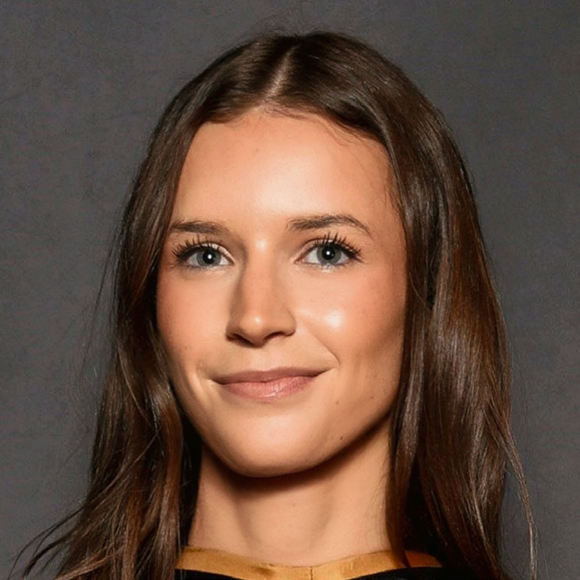
ZONTA WOMEN IN BUSINESS LEADERSHIP AWARD
2024-2026 total funding: US$100,000
10 international awards of US$10,000 each.
Districts with at least 1,200 members at the beginning of the financial year of the award may submit two applications.
Mikaela Morelli
2025 ZWiBL
Zonta Club of Hamilton1
Club Presentation 2026
Notes:
The Zonta Women in Business Leadership Award celebrates excellence and recognizes outstanding achievements by women between 18-35 years of age driving innovation and impact in the business world. This prestigious award honors exceptional leadership, entrepreneurial spirit, ethical conduct and significant contributions to the recipients’ respective industries while addressing global or local issues affecting women and girls or climate justice. The program will operate at the club, district and international levels of Zonta. Districts will choose a district winner from the applications submitted by clubs and submit the district winner’s application to Zonta International in accordance with the separately communicated timeline. Districts with at least 1,200 members as of the beginning of the financial year in which the award will be issued may submit two applications. Ten (10) awardees will be selected by an independent jury of experts consisting of Zontians and non-Zontians, if chosen, appointed by the President.
During the 2024-2026 Biennium, Zonta International will present 10 awards of US$10,000 each, and each international winner will be offered a complimentary one-year supporting membership in Zonta International for the next financial year. Funding for the Award will come from the Zonta Foundation for Women Rose Fund.

Slide 22
ENDOWMENT GIFT FUNDS
Endowment Fund
Created in 1988
Provides a long-term source of income for the Foundation
US$9,749,679
Amelia Earhart Fellowship Endowment Fund
Created in 1998
Provides a long-term source of income for the AE Fellowship program
US$1,242,041
Club Presentation 2026
Notes:
Endowment Fund
Provides a long-term source of income for the Foundation. The principal of the gift is never spent, allowing the Fund to grow over time. Interests and earnings from the investments are not currently spent and go back to the Endowment Fund to continue to grow. At a future point, the Fund interest and earnings may be used to provide the Foundation with an annual stream of income to be designated by the Zonta Foundation for Women Board.
DONATIONS to Endowment Funds or Legacy Circle will not be included in your personal biennial giving total since those will be investment funds will never be spent.
The Zonta Foundation for Women’s Endowment Fund was established in 1988. The Fund saw nominal growth in the following years. It was not until the Centennial Anniversary Endowment Campaign that the Fund started to have significant growth in principal. The CAEC greatly increased member awareness of the importance of the Endowment Fund.
Amelia Earhart Fellowship Endowment Fund
Provides a long-term source of income for the Amelia Earhart Fellowship program. The principal of the gift is never spent, allowing the Fund to grow over time. The interests and earnings from the investments in this fund provide an annual stream of income to support AE fellowships.
This biennium US$48,000 is being used to help support the AE Fellowship program.
Donations to the Endowment Funds do not count toward our biennial goal as that money is invested with the generated income utilized for future projects and programs. Only the donations made to the project and program funds count toward our fundraising goal as that money supports our service projects and educational programs for the current biennium.
Funds are invested in accordance with the established Foundation policies with risk actively managed.
*GIFT TOTALS AS OF 30 April 2025

Slide 23

THE ZONTA 1919 LEGACY CIRCLE
Established to honour individuals who entrusted their legacy to the Foundation through a planned gift.
Club Presentation 2026
Notes:
Planned and legacy giving is an excellent way to establish a charitable legacy, by leaving a part of your estate to the Zonta Foundation for Women.
As members and even supporting non-members review their estate plans, they may consider the many types of planned gifts available. A bequest of a specific amount, life insurance policy, stocks or other financial instruments, that can offer benefits to donors and their families, in addition to supporting the next generation of women and girls.
Donors who choose to make a planned gift to the Foundation, will be welcomed as a member of The Zonta 1919 Legacy Circle or may join anonymously.
Members are asked to complete an application, which is a letter of intent only. They do not need to share their estate documents with Zonta or commit a set amount.

Slide 24
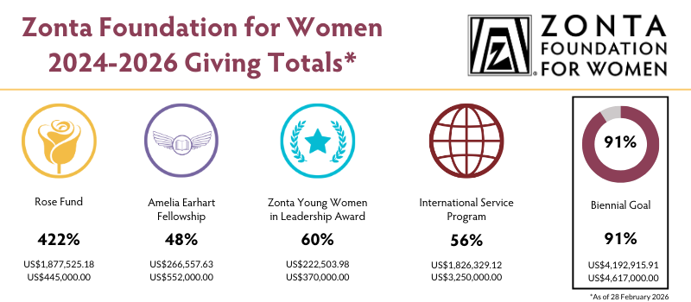
WomenWomen
Club Presentation 2026

Slide 25

When you donate to the Foundation: You make a positive impact on someone’s life
Every contribution makes a difference no matter the amount
Giving to Zonta Foundation for Women creates a sense of connectedness. We are an international organization
Giving to help others without expecting anything in return gives you a sense of joy and fulfillment
Club Presentation 2026
Notes:
When you donate to the Foundation: You make a positive impact on someone’s life

Slide 26
ZONTA INTERNATIONAL Will Continue to NEED
YOUR SUPPORT
Club Presentation 2026

Slide 27
Zonta District 4
As of February 28, 2026
Club donation of US $4625.00
Individual donations total US $477.87
Club Presentation 2026

Slide 28
DISTRICT 4
ZONTA FOUNDATION FOR WOMEN GOALS
1
2
3
4
Every Member Donates At Least One Time During The Biennium
100% of Clubs Donate To The ZFW This Biennium
Increase Club Presentations From Last Biennium
Increase Monetary Donations From Individual Members And Clubs
Club Presentation 2026
Notes:
Goal 1: 26.3% of our District 4 members have given to the ZFW this biennium up from
Goal 2: 28 clubs out of 30 so far have made a donation to the ZFW this biennium totalling over $71,433.33
Gaols 3: we have increased the number of presentations to D4 clubs.
Goal 4: 176 D4 members have donated $23,334.51 in this biennium vs 152 D4 members gave $19,903.65 last biennium.
.

Slide 29
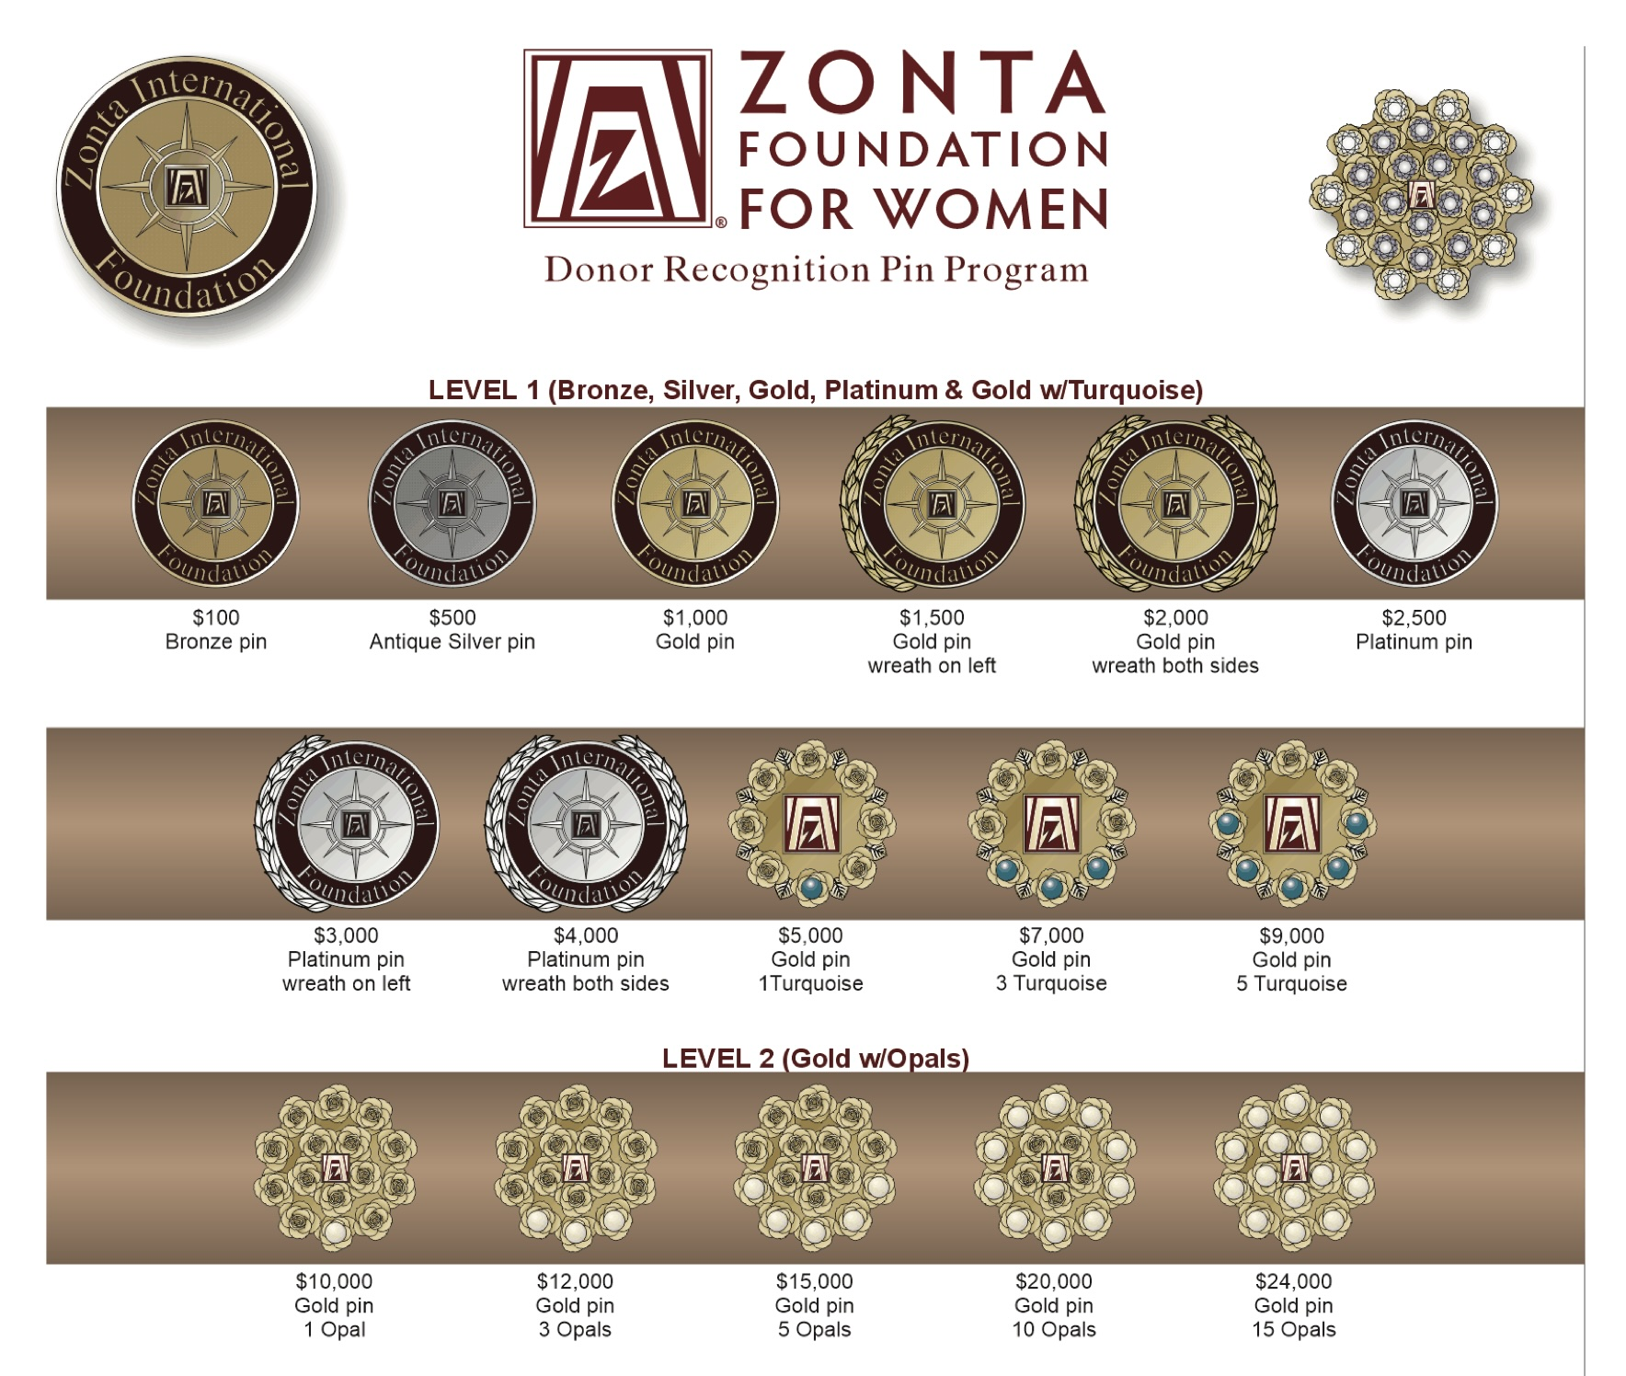
Pin Recognition for Individual Donations
Members receive a donor pin that recognizes their donation level.
We ask that you return your pin when receiving the next one.
D4 ZFW Committee will collect pins from members at D4 events and Summits to return to ZI Foundation at the 2026 Convention.

Slide 30

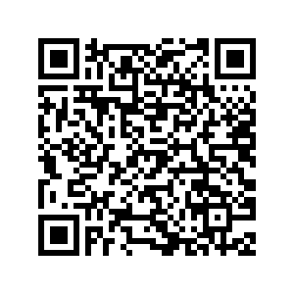
AND, If You Do Donate $2000.00 US TO ZFW
You will be invited to attend the ZFW Reception at the 2026 Convention.
ZFW Donation Page
Club Presentation 2026

Slide 31
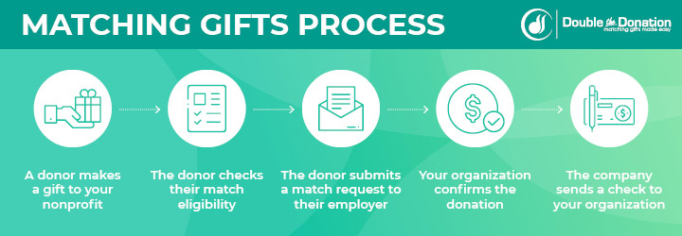

ADDITIONAL WAYS TO GIVE
Matching Gift Program
Check with your employer to find out if they will match gifts to the Foundation.
Facebook Fundraisers
Help raise funds through your network of friends and family.
Club Presentation 2026
Notes:
In addition to submitting donations online, via wire or SEPA transfers, or collected at local events, donors can also take advantage of additional ways to contribute to the Foundation.
Donors should check with their employers to see if they are able to receive a matching gift for a personal donation or for volunteer hours.
Facebook fundraisers have become more popular. Donors can set up fundraisers on their personal page and reach out to their social circle to introduce them to Zonta and help raise funds.

Slide 32
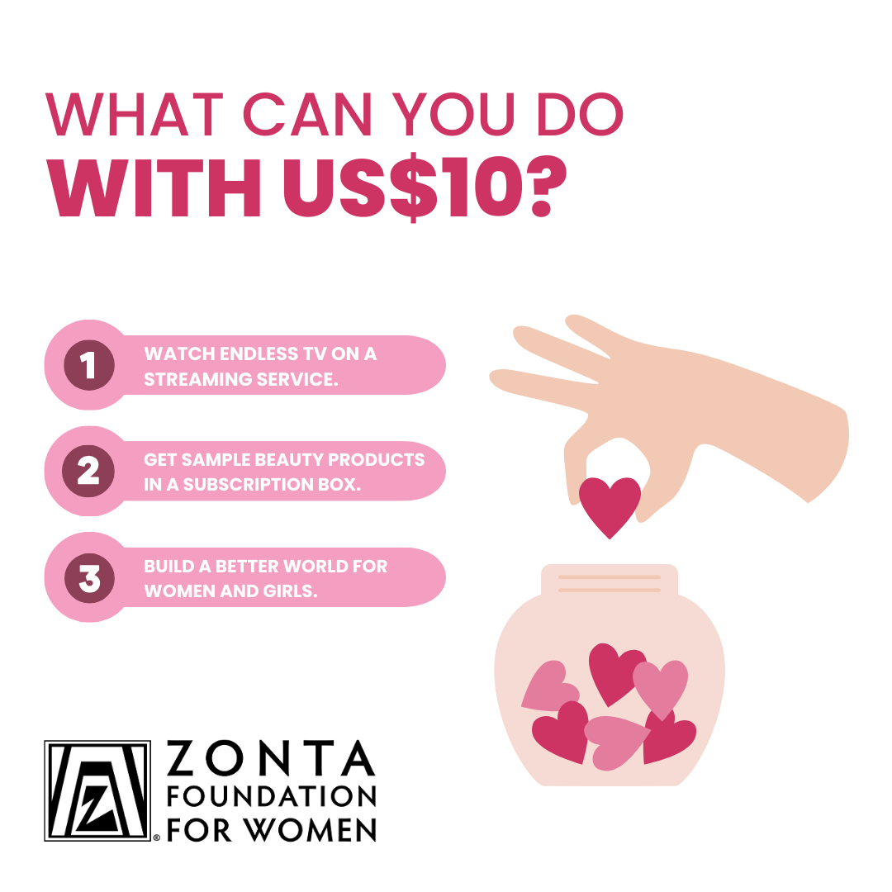
TOGETHER WE CAN MAKE A DIFFERENCE
A gift of any size helps the Foundation support projects and programs that make gender equity a reality for women and girls worldwide.
Join hundreds of others and set up a monthly gift to the Foundation to build a better world for women and girls.
Club Presentation 2026

Slide 33
Charitable giving is an act of kindness that has a very positive impact to Build a Better World for Women and Girls.
You can also impact the future for generations by creating a legacy.
ZFW Donation Page
Club Presentation 2026

Slide 34
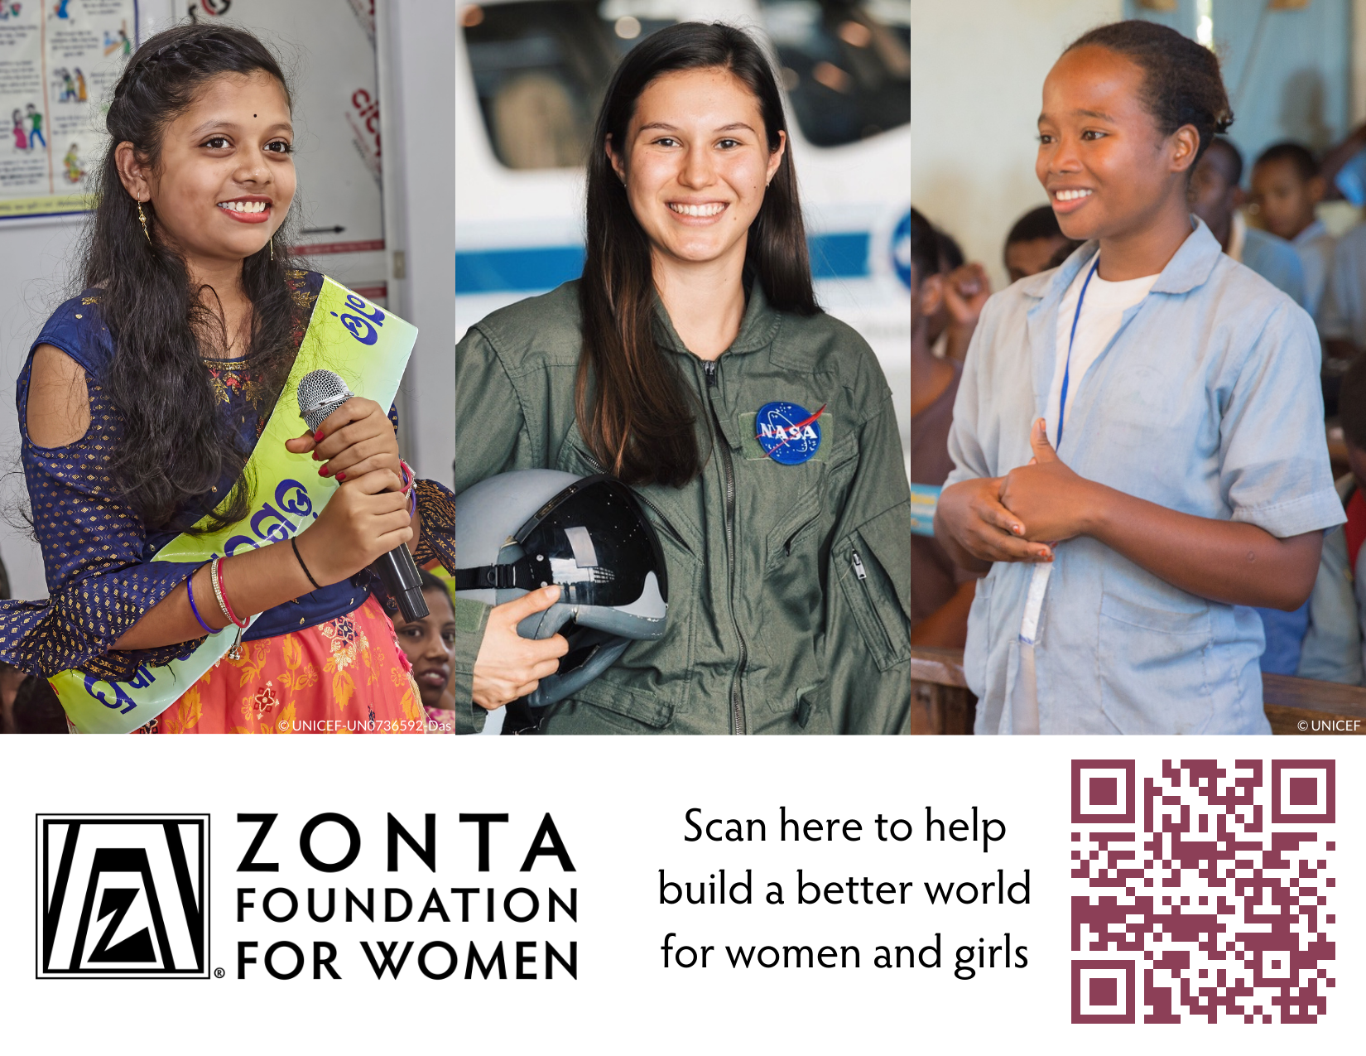
T
Thank You, District 4!
Club Presentation 2026

Slide 35
How to Make an Online Donation
Go to
Click on
Fill in
That’s it
Zonta International website
https://zonta.org
Your Support
Donate Now
The online form with donor and payment details
Thank You!
Club Presentation 2026

Slide 36
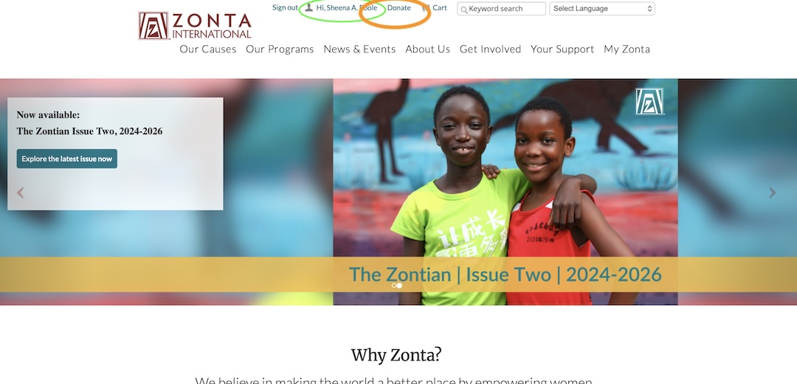
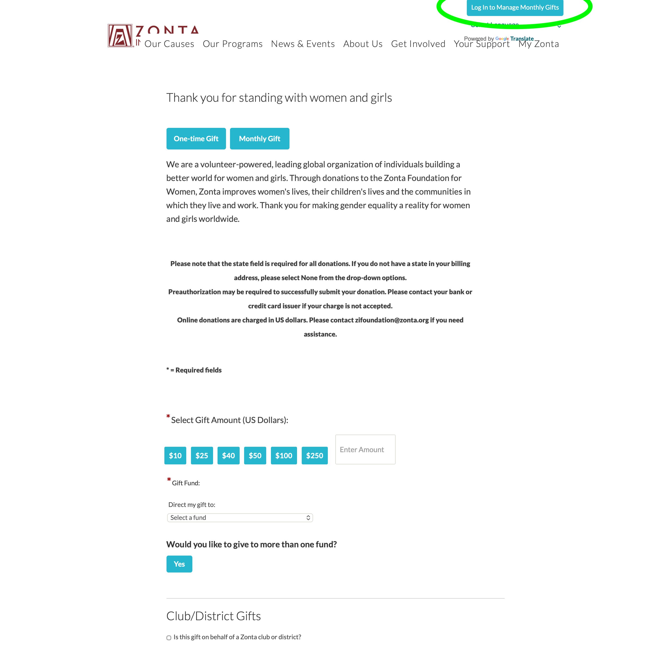
Acessing ZI Member General Donation Page
Make a Donation to ZFW
Make a Tribute Gift
In memory of someone
In honour of someone
Notes:
Make a donation to ZFW
Tribute donation to honour a person or in memory
Click “Log in to manage monthly gifts” in the top-right corner of the page to access & view your personal donations.
You will be taken to a login page that is different from your access to My Zonta login.

Slide 37
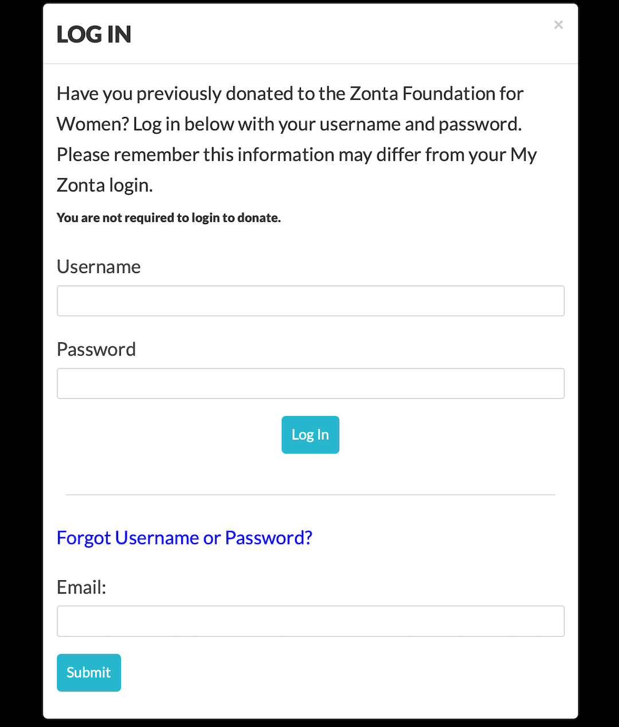
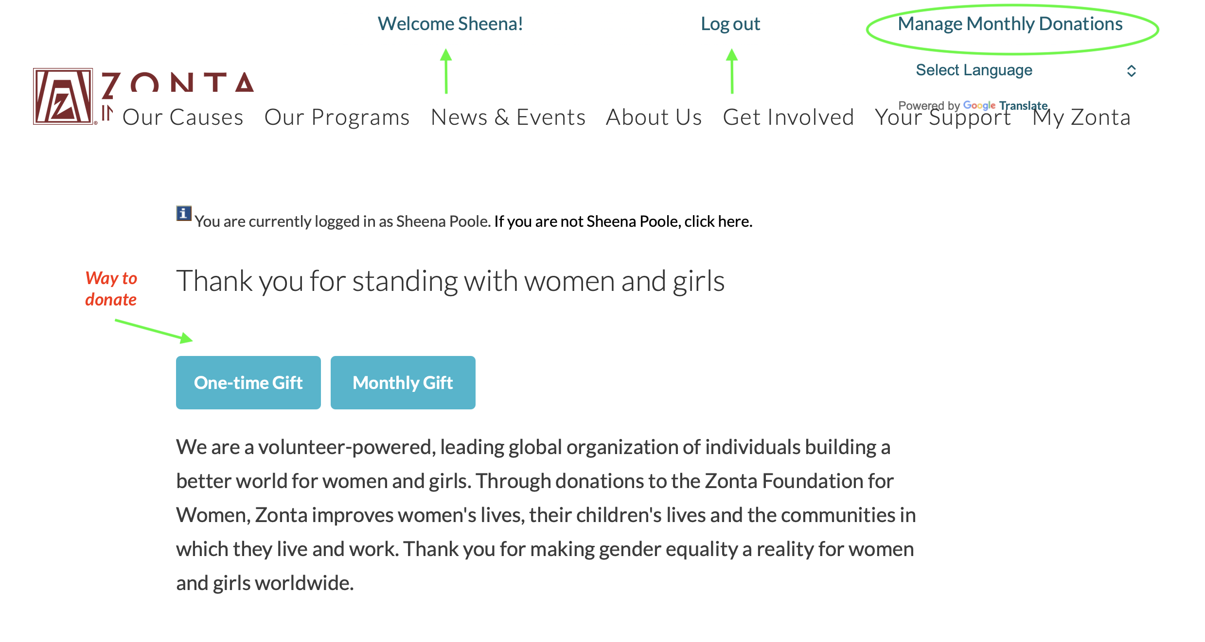
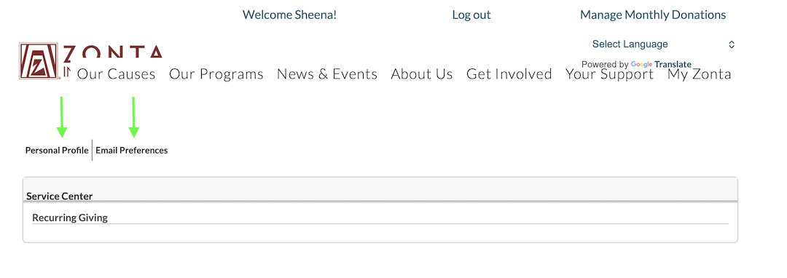
Sign in to Access
Notes:
Use your email address on file with ZI to create a password for the ZFW secure site.
Click Manage Monthly Donations to access the site to view and edit your personal profile and email preferences.

Slide 38
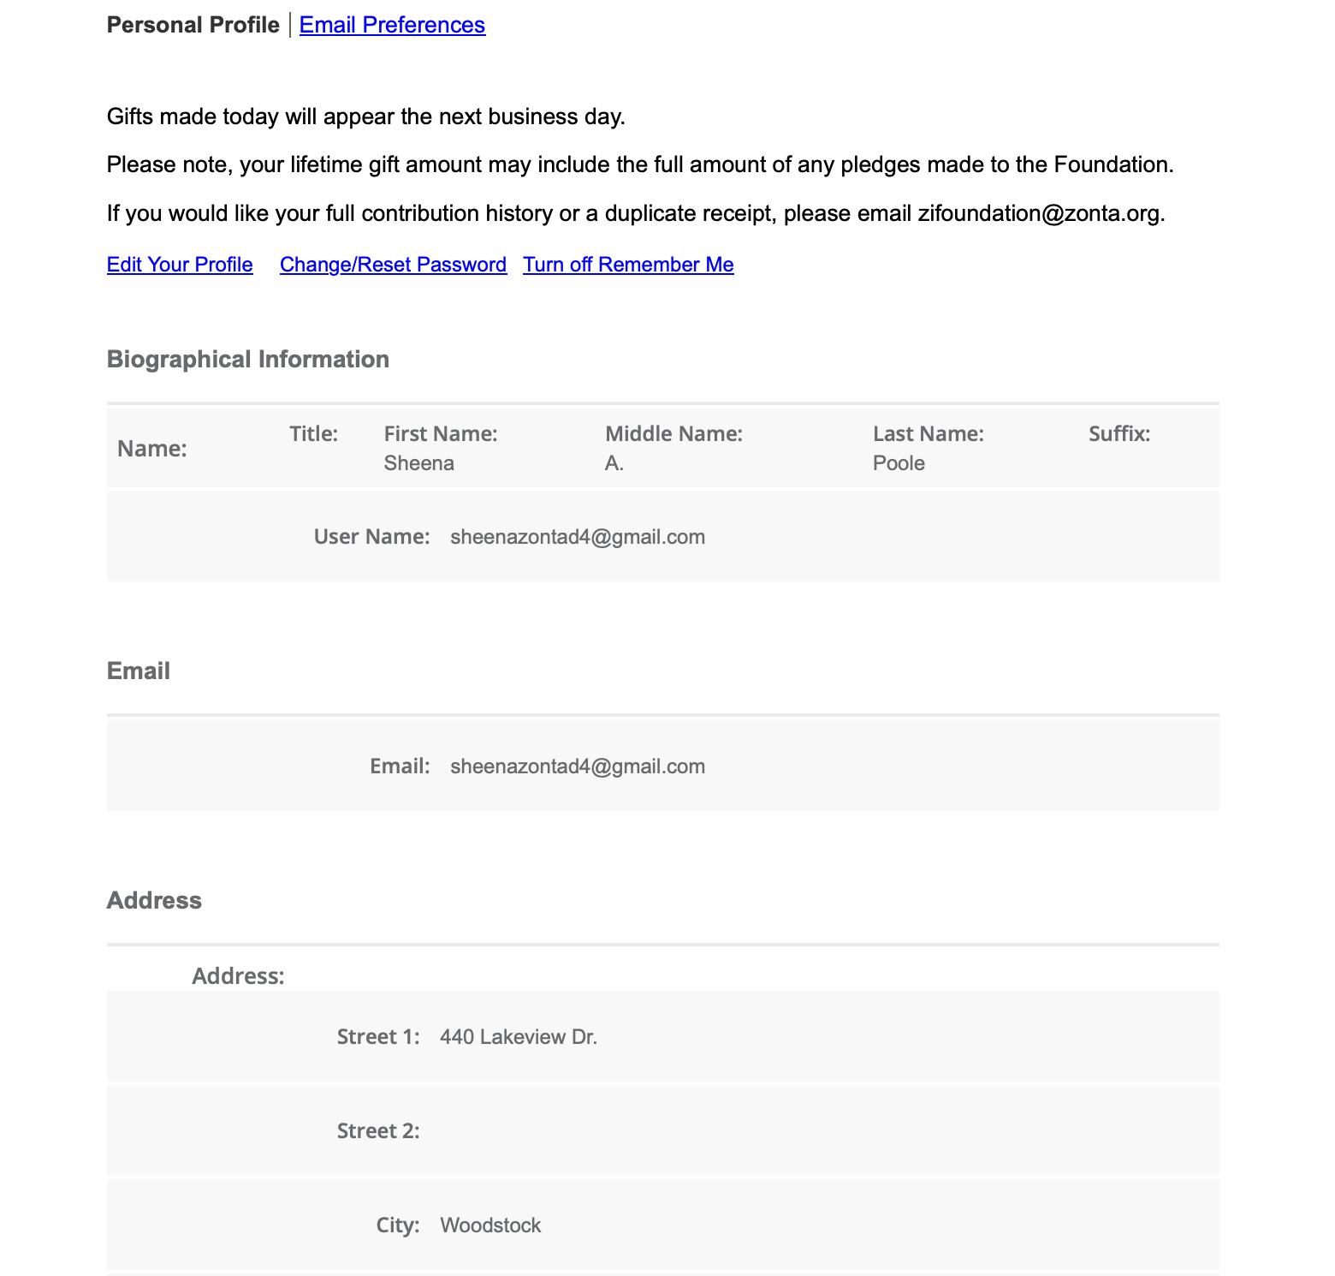
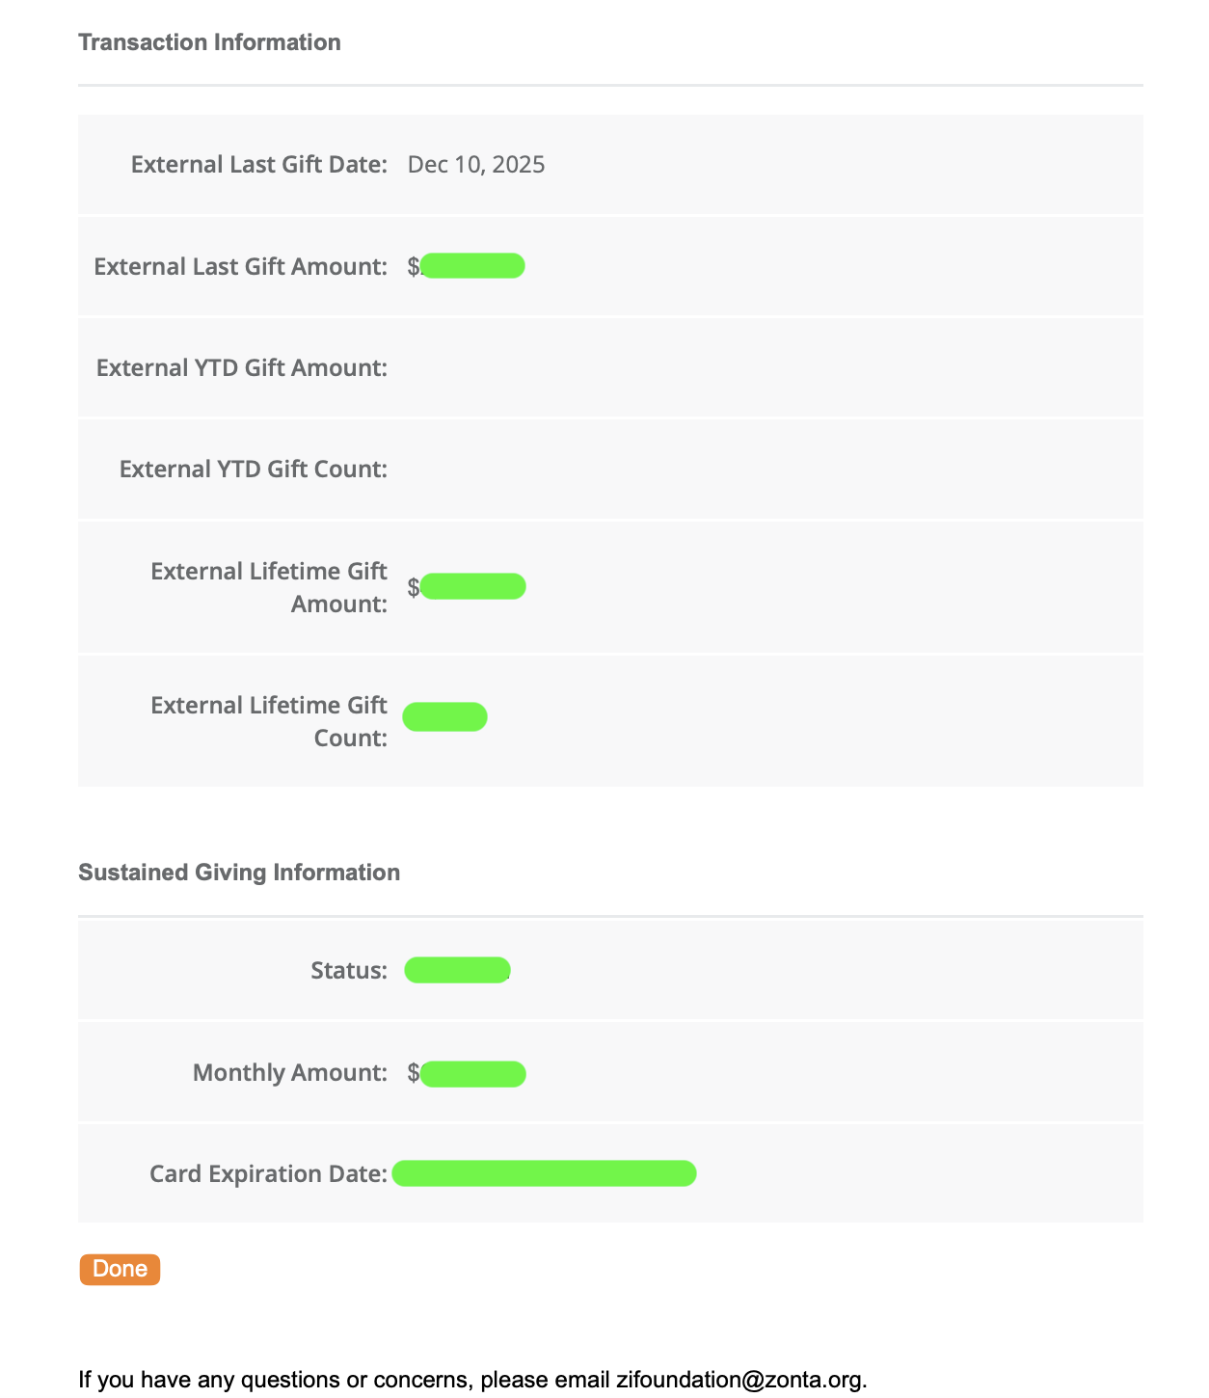
Member Donor Page
Contact HQ Zonta Foundation for Women - Eva Mikos zifoundation@zonta.org for personal donation history
Notes:
On your personal profile page you will see all information related to your personal giving.
Including: last gift, Year To Date gift amount, lifetime gift amount and number of gifts made.
Area for setting up monthly donations using your credit card.
Please contact zifoundation@zonta.org if you wish to receive an account of all personal donation transactions you made to the Foundation.

