Slide 1


ZONTA CANADA CAUCUS
Sheena Poole, Zonta Canada Caucus Convener

Slide 2

Introduction to the Zonta Canada Caucus
Elevating impact and unifying Zonta advocacy across Canada, including club efforts
The Caucus will provide local Clubs:
  practical tools
  Canadian- specific resources
  templates
The Caucus will help local Clubs:
  streamline preparation
  strengthen messaging across the nation
  increase impact in their local communities
Notes:
Frame the Caucus as a national support system to strengthen and unify advocacy.
All our Canadian clubs are in districts that have a high percentage of American clubs and often lack Canadian-specific content.
The reason why Zonta Canada is not just focused on legislative action. It is meant to help clubs and encourage mutual support.
Emphasize practical, ready-to-use resources designed to reduce barriers and lighten the load for Clubs—especially those with limited capacity.
The Zonta Canada Caucus is set to elevate and unify advocacy efforts for Clubs across the country. With a focus on national alignment, Canadian-specific resources, and practical tools, the Caucus will help Clubs streamline preparation, strengthen messaging, and increase impact in their local communities.

Slide 3
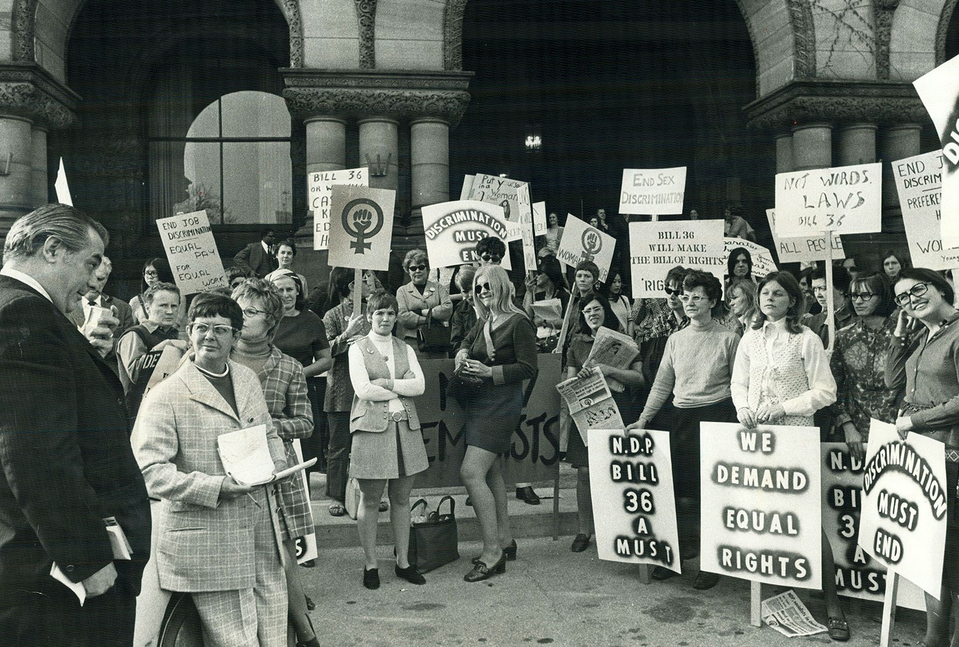
Zonta Canada Caucus Purpose & National Goals
National alignment for coordinated advocacy efforts for greater impact.
Streamlined preparation and stronger messaging across Canada.
Support for Clubs to increase impact locally.
With a focus on national alignment, Canadian-specific resources, and practical tools, the Caucus will help Clubs
    streamline preparation,
    strengthen messaging
    increase impact in their local communities
Notes:
Highlight national alignment: consistent messaging and coordinated actions across Canada.
Explain how streamlined prep helps Clubs spend more time on local impact.
Reinforce that the goal is confidence and efficiency in advocacy.

Slide 4

2026 Zonta Canada Caucus Strategic Plan
Aligned with Zonta International Strategic Plan
  Credible and Visible Voice
  Club Success
  Engagement of Audiences & Allies
  International Leadership & Sustainability
Notes:
Strategic Plan is a living document with goals, actions and deadlines.

Slide 5

Supporting Our Canadian Clubs
Two-way dialogue via surveys, easy access to Canadian data, resources, information.
Ready-to-use advocacy tools and messaging templates.
Campaign-in-a-box toolkits for national days
Canada-specific data: GBV, IPV, cyber bullying, human trafficking etc.
Resources to simplify local advocacy.
Recommendations / ideas on advocacy at the Club level.
Cross-Club learning and national alignment.
Notes:
Walk through supports: toolkits (guides, sample letters, media templates), campaign-in-a-box assets for key dates, and Canada-specific data (GBV, IPV, cyber safety, trafficking, climate impacts). Mention cross-club learning and shared best practices.

Slide 6
Who We Are
National Level Advocacy Groups
Conveners appointed by International President
  ZONTA AUSTRALIA
  ZONTA AUSTRIA
  ZONTA BULGARIA
  ZONTA CANADA - Sheena Poole, D4
  ZONTA DENMARK
  FRENCH UNION OF ZONTA CLUBS
  UNION OF GERMAN ZONTA CLUBS
  ZONTA ITALIA
  SWISS UNION OF ZONTA CLUBS
  ZONTA USA CAUCUS
Zonta Canada Caucus
Five Districts with Canadian/American Clubs
  one delegate and one alternate
  Appointed by District Governor
District 1 – No Canadian Delegate
  Represented by D1 Governor Donna Raycraft (USA)
District 2
  Delegate Val Hume, ZC of Ottawa
  Alternate Elspeth Nickle, ZC of Stittsville-Kanata
District 4
  Delegate Nita McCown, ZC of Toronto
  No Alternate
District 15 – No Canadian Delegate
  Represented by D15 Gail Johnson (USA)
District 8 – No Canadian Delegate
  Represented by D8 Governor Stephanie Adams
Notes:
Frame the Caucus as a national support system to strengthen and unify advocacy.
Emphasize practical, ready-to-use resources designed to reduce barriers and lighten the load for Clubs—especially those with limited capacity.
The Zonta Canada Caucus is set to elevate and unify advocacy efforts for Clubs across the country. With a focus on national alignment, Canadian-specific resources, and practical tools, the Caucus will help Clubs streamline preparation, strengthen messaging, and increase impact in their local communities.

Slide 7

2026 Webinar & Campaign Toolkits
Webinar open to all Canadian members
  Monday, March 16th Zoom at 7:30 PM EST
Develop Caucus’s goals and strategic approach.
How coordinated national resources will simplify local advocacy.
Expectations for upcoming toolkits, templates, and data sheets
How Clubs can align national messaging with local priorities
Notes:
Describe the March national webinar: meet delegates, review materials, and learn strategies for engaging MPs, municipal leaders, and media. Explain the April Member Survey’s purpose—capturing needs, barriers, and priorities—so toolkits, data sheets, and media templates reflect real Club requirements.
National webinar: goals, strategy, resources, local alignment.
Member Survey coming this Spring to shape toolkits and materials, determine Club needs, learn barriers; better understand needs and deliver on those requirements.
Survey informs data sheets, media templates, activation resources, toolkits moving forward.
The Caucus’s goals and strategic approach.
How coordinated national resources will simplify local advocacy.
Expectations for upcoming toolkits, templates, and data sheets
How Clubs can align national messaging with local priorities
Survey results will directly shape:
campaign toolkits
messaging guides
Canadian data and fact sheets
media templates
local activation resources

Slide 8


Early 2026 National Spring Campaign 1
Access to and Links to Canadian data and resources to leverage, minimizing “heavy lifting” for the Clubs.
ready-to-launch materials and resources for unified Canadian messaging
Human Trafficking Awareness Day (Feb 22).
International Women’s Day & Zonta Rose Day (Mar 8).
Notes:
Preview two coordinated campaigns: Feb 22 Human Trafficking Awareness Day and Mar 8 International Women’s Day & Zonta Rose Day. Explain that unified messaging, Canadian data, and ready-to-launch materials will be provided so Clubs can activate quickly and consistently.

Slide 9

Human Trafficking Toolkit
Outline of Toolkit
Reports on HT
Quick Facts
Canadian Resources
One pager with Video
Email letter template for local leadership
Social media posts
  Individual district / club personalization.
  Separated into six categories to mix and match
Notes:
Walk through supports: toolkits (guides, sample letters, media templates), campaign-in-a-box assets for key dates, and Canada-specific data (GBV, IPV, cyber safety, trafficking, climate impacts). Mention cross-club learning and shared best practices.

Slide 10
IWD/ Yellow Rose 2026
Recognizing the Remarkable
Goals
1. Raise funds for the Foundation by encouraging donations in recognition of remarkable women who have inspired members and donors. (Goal: US$100,000).
2. Engage local communities by showcasing the benefits of Zonta at Yellow Rose events and International Women’s Day events.
3. Inspire members to take actions that align with the Core Values of Zonta while enjoying benefits of membership by having them play a Zonta customized game of "Bingo" throughout the month of March.
4. Showcase women affiliated with Zonta by highlighting our Remarkable Women Powerful Stories podcast guests and International Honorary Members.
Yellow Rose Campaign Toolkit to help achieve above goals:
Donation Postcard |Canva Template Link
Event flyer template | Canva Template Link
Zonta Yellow Rose Logo | .jpeg | .png
Zonta Yellow Rose Bingo | coming soon
Remarkable Women Powerful Stories podcast | Link
International Honorary Members | Link
Notes:
Walk through supports: toolkits (guides, sample letters, media templates), campaign-in-a-box assets

Slide 11
Using Your Voice in Non-partisan Manner
This International Women’s Day, there are a number of activities planned. Including marches and protests and a Global Women’s General Strike on March 9th. As a global advocacy organization, Zonta International encourages members to use their voices to speak up for the rights of women and girls whenever and wherever possible.
However, if you as a Zontian participate in these activities, either on International Women’s Day or at any other time, in Zonta-branded apparel or accessories and/or carry Zonta-branded signage, please remember your participation and messaging reflects Zonta International and must remain non-partisan. Zonta Says NO to Violence Against Women, Zonta Says NOW to Gender-Equal Climate Action, Ending Child Marriage and Equal Pay for Equal Work are good examples of non-partisan and Zonta-aligned messaging.
Notes:
Just a reminder!

Slide 12

2026 Spring Survey
Member Survey (Spring) to help shape toolkits and materials by identifying Club needs & barriers
Survey results will directly shape:
  campaign toolkits
  messaging guides
  Canadian data and fact sheets
  media templates
  local activation resources
Notes:
Describe the March national webinar: meet delegates, review materials, and learn strategies for engaging MPs, municipal leaders, and media. Explain the April Member Survey’s purpose—capturing needs, barriers, and priorities—so toolkits, data sheets, and media templates reflect real Club requirements.
National webinar: goals, strategy, resources, local alignment.
Member Survey coming this Spring to shape toolkits and materials, determine Club needs, learn barriers; better understand needs and deliver on those requirements.
Survey informs data sheets, media templates, activation resources, toolkits moving forward.
The Caucus’s goals and strategic approach.
How coordinated national resources will simplify local advocacy.
Expectations for upcoming toolkits, templates, and data sheets
How Clubs can align national messaging with local priorities
Survey results will directly shape:
campaign toolkits
messaging guides
Canadian data and fact sheets
media templates
local activation resources

Slide 13

What We Ask..
Ask us to speak to your club.
Share with your Club’s Advocacy Chair
Visit Zonta Canada website for ongoing updates and access to new resources: https://zontacanada.ca/
Read Bulletin Updates
Submit advocacy actions and keep apprised of Canadian Club activities on the website events calendar at https://zontacanada.ca/news-events
Be on the lookout for toolkit resources for Feb. 22nd and March 8th programs.
Notes:
Reminder of all the various ways you can access the content, keep apprised of Canadian Club activities, as well as resources and toolkit elements for campaigns, advocacy etc.
Also a reminder to copy and share the accompanying 1 pager document that highlights the key information from this webinar – and share the recording with Club Members who may not have been able to attend.
Club Calendar of events – how to submit your event / activity for posting on the Canada website?

Slide 14

Questions? Feedback?
Notes:
If you wish to solidify final points again: Frame the Caucus as a national support system to strengthen and unify advocacy.
Emphasize practical, ready-to-use resources designed to reduce barriers and lighten the load for Clubs—especially those with limited capacity.
The Zonta Canada Caucus is set to elevate and unify advocacy efforts for Clubs across the country. With a focus on national alignment, Canadian-specific resources, and practical tools, the Caucus will help Clubs streamline preparation, strengthen messaging, and increase impact in their local communities.

Slide 15


Thank You!
Notes:
Thank everyone.

